Slide 1
Plasmonic Transistors For Terahertz-band Communication
Dr. Jonathan Bird
(Professor & Chair
Department of Electrical Engineering)
Aarbaj Mundaganur
Shahabaj Mundaganur
November 3rd 2023

Slide 2
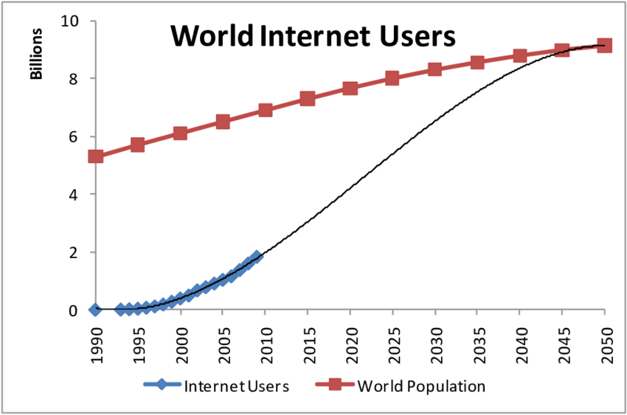
Demand for High-Speed, High-Bandwidth Data Communication
In January 2023, 5.16 billion people worldwide had internet access.
In just the past five years, we've seen an additional 1.2 billion users join this community.
With increase in internet users, consequently the demand for higher data rates will continue to increase.
~8 Billion
We are here
~5 Billion
2023
Source: Trotman, Andrew & Zhang, Jinglan. (2013). Future Web Growth and its Consequences for Web Search Architectures.
Note: Data sourced from the 'Digital 2023: Global Overview Report' by Simon Kemp, dated 26 January 2023.

Slide 3
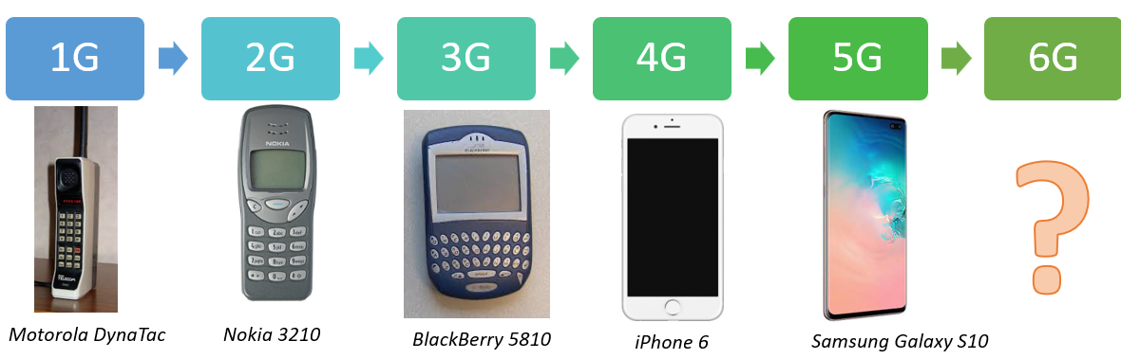
Evolution of Communication Networks
1 Gbit/s
100 Mbit/s
2 Mbit/s
64 Kbit/s
2.4 Kbit/s

Slide 4
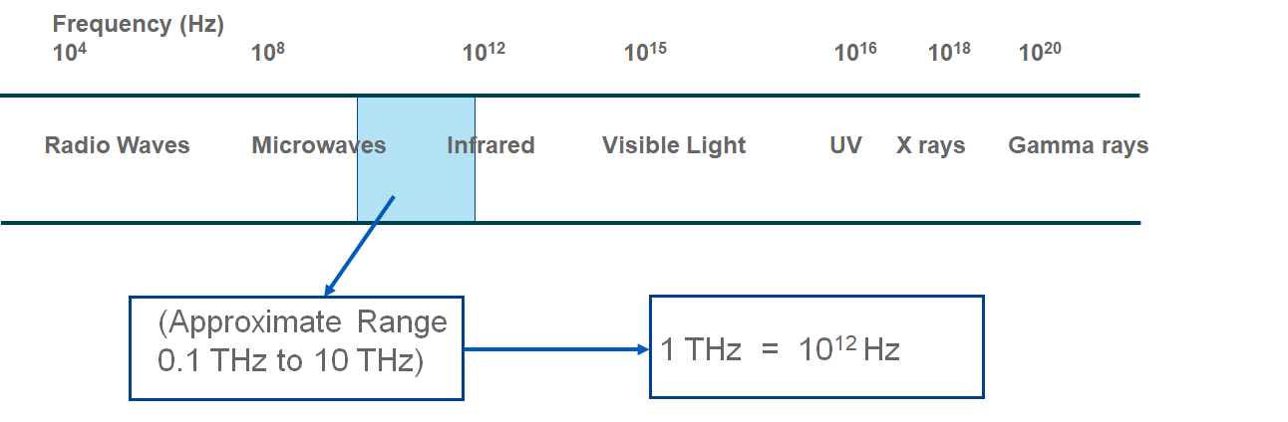
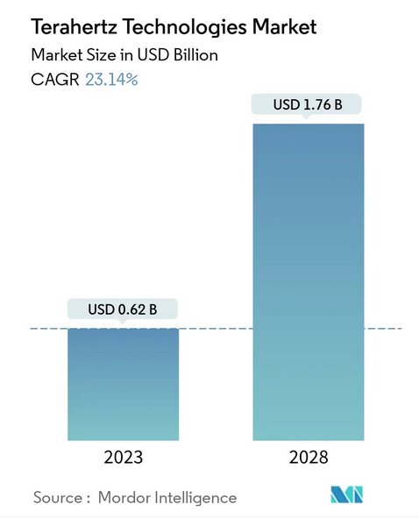
Exploring Terahertz Spectrum for Next Generation Communication Schemes
Wavelength | Absorption | Energy | Penetration
3 mm to 30 um | Strongly absorbed by water & organic substances | Low energy, Non-ionizing radiation | High penetration compared to visible light

Slide 5
Our Primary Objective
To develop high speed, compound semiconductor based plasmonic transistors suitable for next generation of communication schemes.
These devices will operate at THz frequencies.

Slide 6
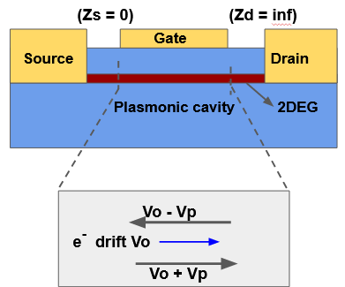
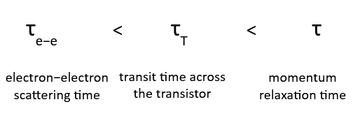
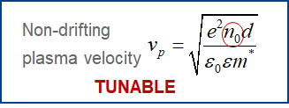
Dyakonov and Shur Instability For Plasma Wave Oscillations
Pioneering work done by Dyakonov and Shur in 21 June 1993.
Asymmetric boundary conditions required for the plasma waves growth under DC drain bias.
Adapted from M Dyakonov, M Shur Phys. Rev. Lett. 71, 2465 (1993)

Slide 7
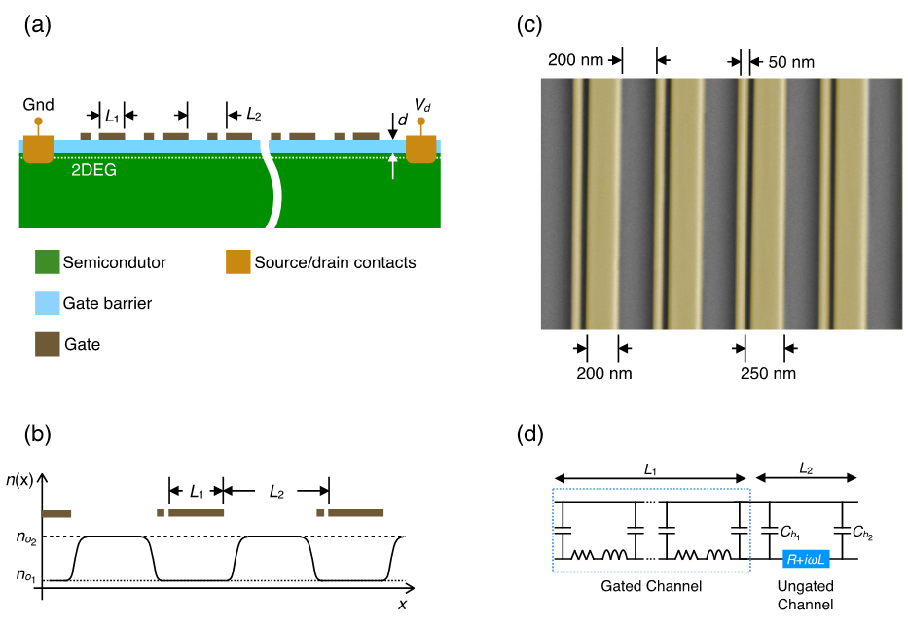
Our Plasmonic Device Design
Theoretical study of a semiconductor field-effect transistor designed with a dual grating gate.
Plasma oscillations in the individual elementary cells are coupled to one another via EM interaction.
A drastic enhancement of the radiated EM power should occur due to coherent addition of the EM waves generated in different cells.
Notes:
Periodic modulation of the 2D electron channel leads to the formation of a plasmonic crystal.

Slide 8
DS Instability in Plasmonic Asymmetric Gate Array Device
Equivalent electric circuit diagram of the gate array
C_{b}= αεε₀W
A fringing capacitance is formed between the 2D electron layer and the gate edge.
The fringing capacitances will be different at the opposite edges of this gate.
(C_{b2} ≠ C_{b1})
Asymmetric Factor = γ = C_{b2} / C_{b1} > 1

Slide 9
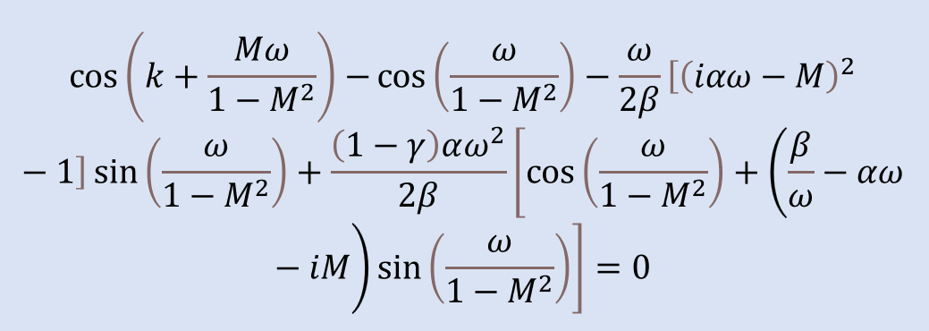
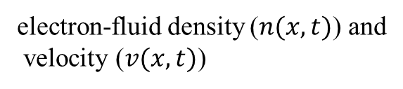
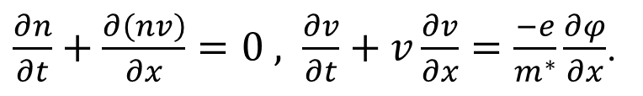
Theoretical Model
Hydrodynamic equations based on Dyakonov and Shur shallow water analogy
electron-fluid density ($n(x,t)$) and
velocity ($v(x,t)$)
$\frac{∂n}{∂t}+\frac{∂\left(nv\right)}{∂x}=0 , \frac{∂v}{∂t}+v\frac{∂v}{∂x}=\frac{−e}{m^{∗}}\frac{∂φ}{∂x}$.
α = Geometric factor
β = Ratio of e⁻ density (n₀₁/n₀₂)
γ = Asymmetric factor
M = Mach number = v₀/v_{p}
ω = Plasma frequency
We solve this dispersion equation for $ω$as a function of k.
$ω=ω^{′}+iω′′$

Slide 10
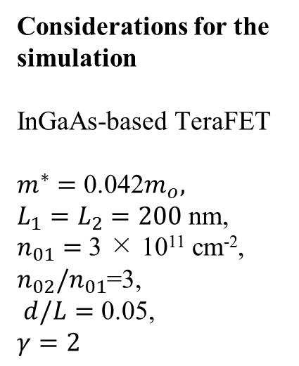
Theoretical Model Simulations
Considerations for the simulation
InGaAs-based TeraFET
$m^{∗}=$ 0.042$m_{o},$
$L_{1}=L_{2}=200$ nm,
$n_{01}=$ 3 × 10¹¹ cm⁻², $n_{02}/n_{01}$=3,
$d/L=$ 0.05,
$$γ=2$$
~2 THz

Slide 11
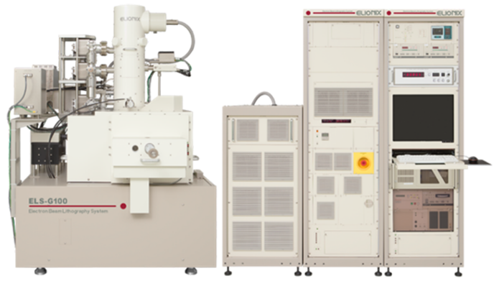
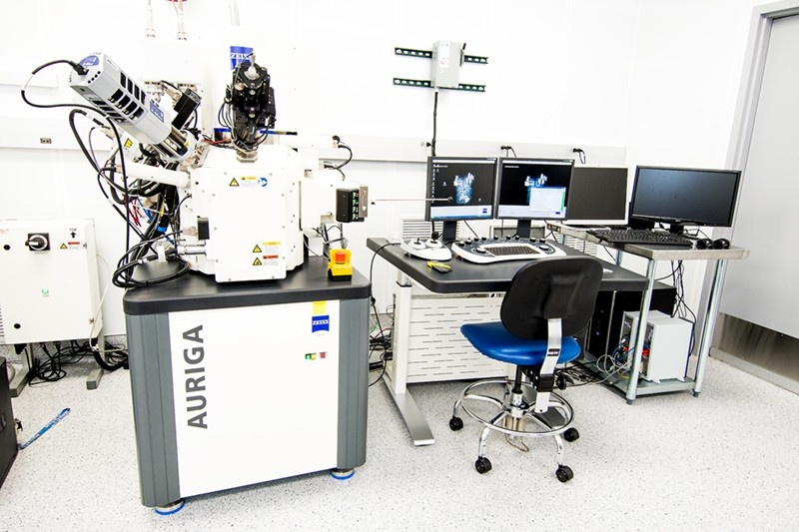
Experimental progress requirement
Electron Beam Lithography Scanning Electron Microscopy
Focused Ion Beam Scanning Electron Microscope
(FIB-SEM) - Carl Zeiss AURIGA CrossBeam
E-Beam Lithography System (100kV)
Elionix ELS-G100

Slide 12
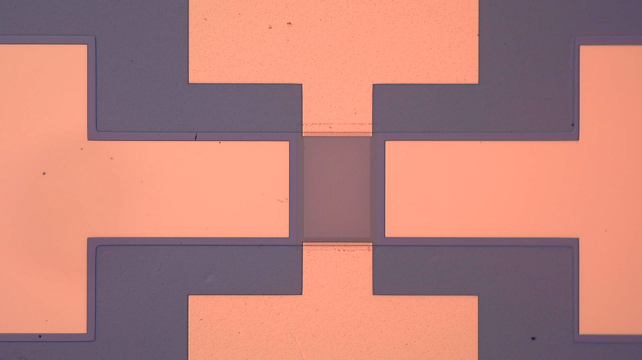
Experimental update on plasmonic device fabrication
Gate I
Mesa Etch
Recess Etch
Drain
Source
25 µm
Gate II
Mesa Etch

Slide 13
Process Flow for Our Plasmonic Device Fabrication
Step | Instrument/ Process | Purpose
1 | EBL | Markers Exposure
2 | E-Beam Evaporator | Markers Metal deposition
3 | EBL | Mesa Exposure
4 | Wet Chemical Etching | Mesa Etch
5 | Citric Acid Etching | Leakage Prevention Etch
Step | Instrument/ Process | Purpose
6 | EBL | Gate recess exposure
7 | Wet Chemical Etching | Gate recess etch
8 | EBL | Gate array exposure
9 | E-Beam Evaporator | Gate array metal deposition
10 | EBL | Contact pads exposure
11 | E-Beam Evaporator | Contact pads metal deposition

Slide 14
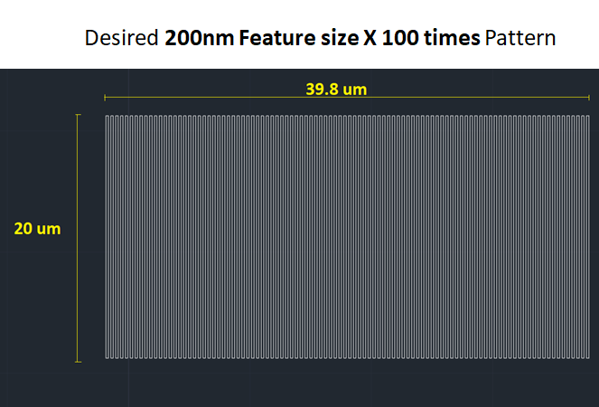
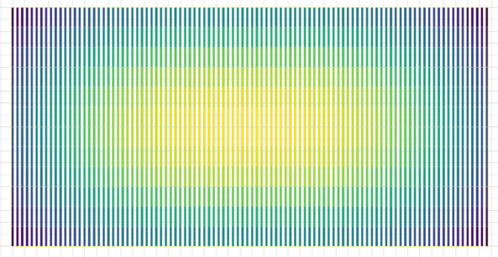
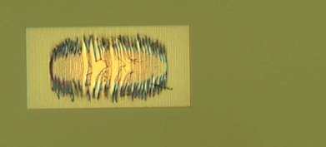
Gate array exposure trials
Gate Array Design
Proximity Error Correction Map
Harsh proximity effect
20 µm

Slide 15
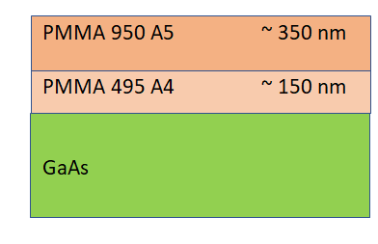
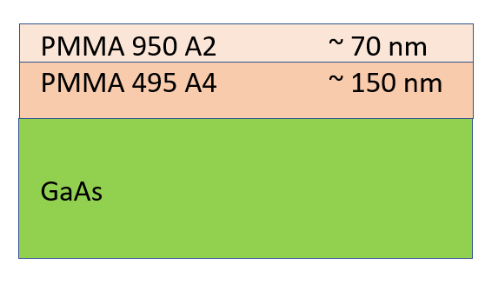
Investigation into reducing proximity error
Reducing the total resist layer thickness
(From 500 nm to 220 nm )
2.Minimizing beam current during EBL exposure. Beam Current = 100 pA
3. Running dose test to identify optimal exposure dose.
4. Maximizing the scanning dot resolution for the EBL to 1,000,000 dots.
Previous Stack
New Stack

Slide 16
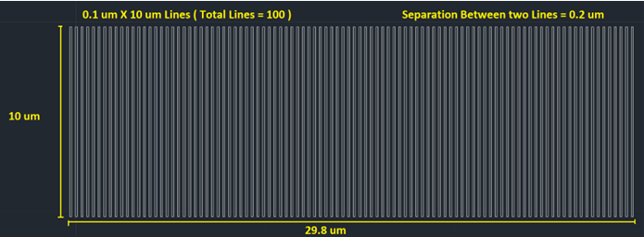
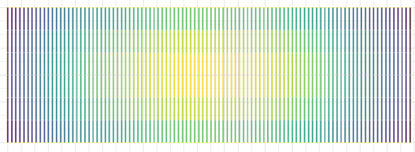
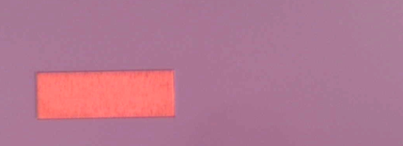
After optimizing proximity correction
Gate Array Design Trial
Proximity Error Correction Map
No harsh proximity effect
Harsh proximity effect
10 µm
20 µm

Slide 17
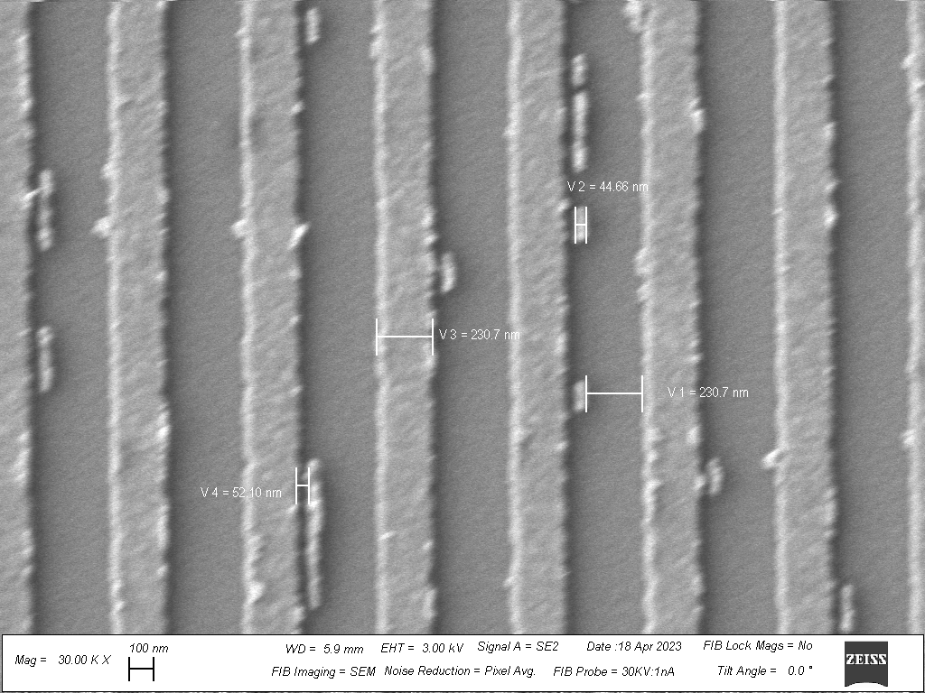
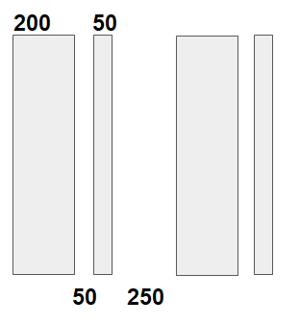
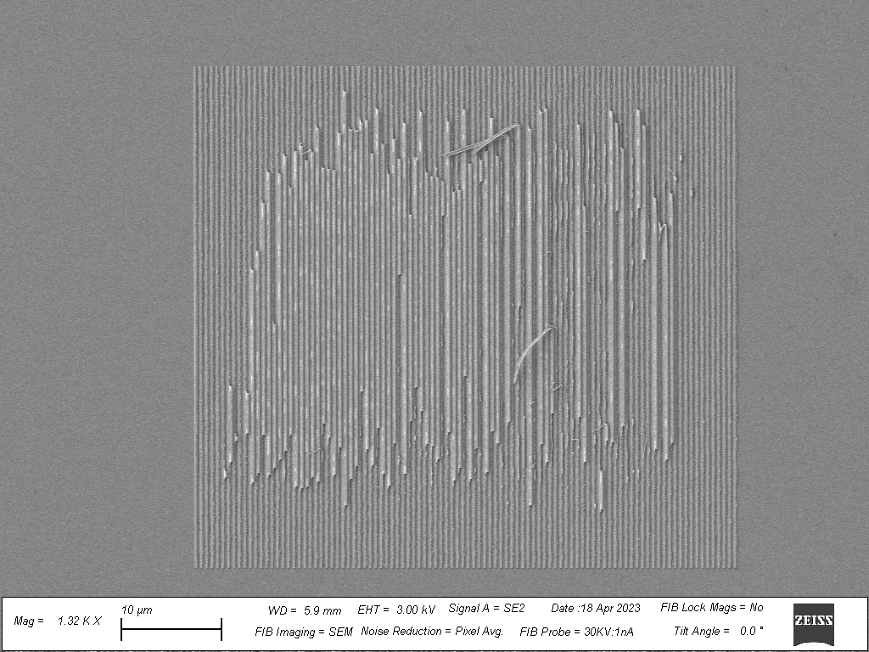
Asymmetric Gate Array Trial
(nm)
(Diagram is for representational purpose only and the scales are in nm)
Dose
460 uC/cm²
230 nm
Gate Width
50 um
Dose
470 uC/cm²
10 µm

Slide 18
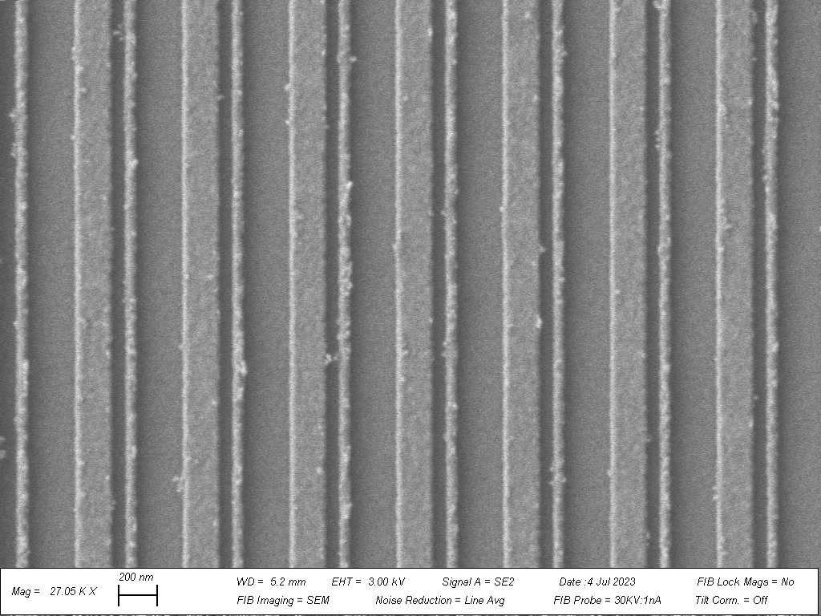
Gate Width
50 um
Optimized Design
Dose
675 uC/cm²
^{GaAs Substrate}
Shorting between gates
200 nm
Dose Increase

Slide 19
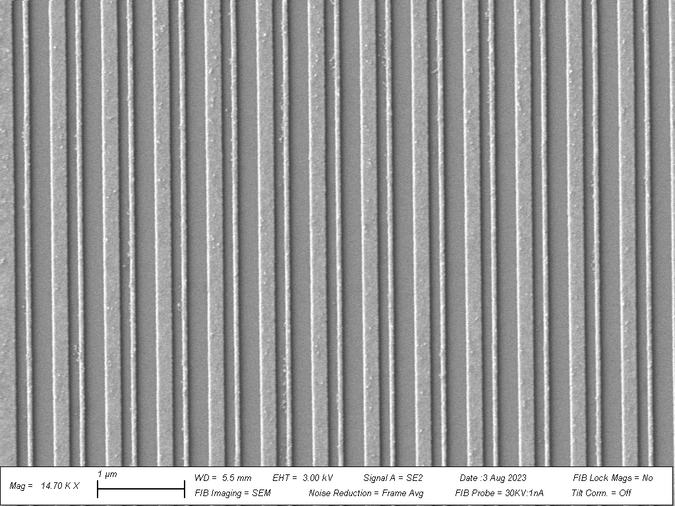
Gate Height 50 um
Dose 700 uC/cm²
Exp. Design
150-150-30-270
Approx. Measurement
180-120-55-240
Dose Increase
1 µm
Metal Thickness Decreases
^{GaAs Substrate}

Slide 20
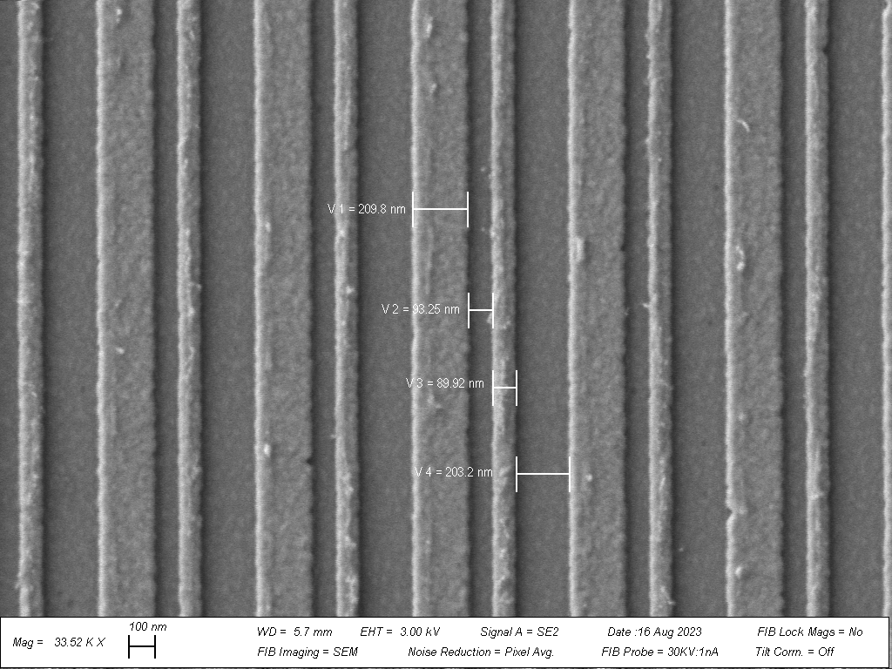
SEM image of an asymmetric gate array pattern fabricated on our heterostructure substrate using EBL
600 nm

Slide 21
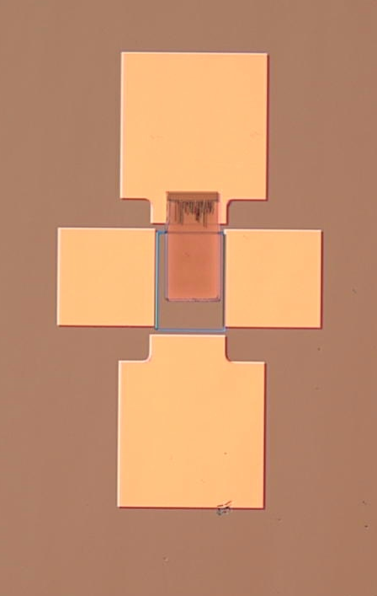
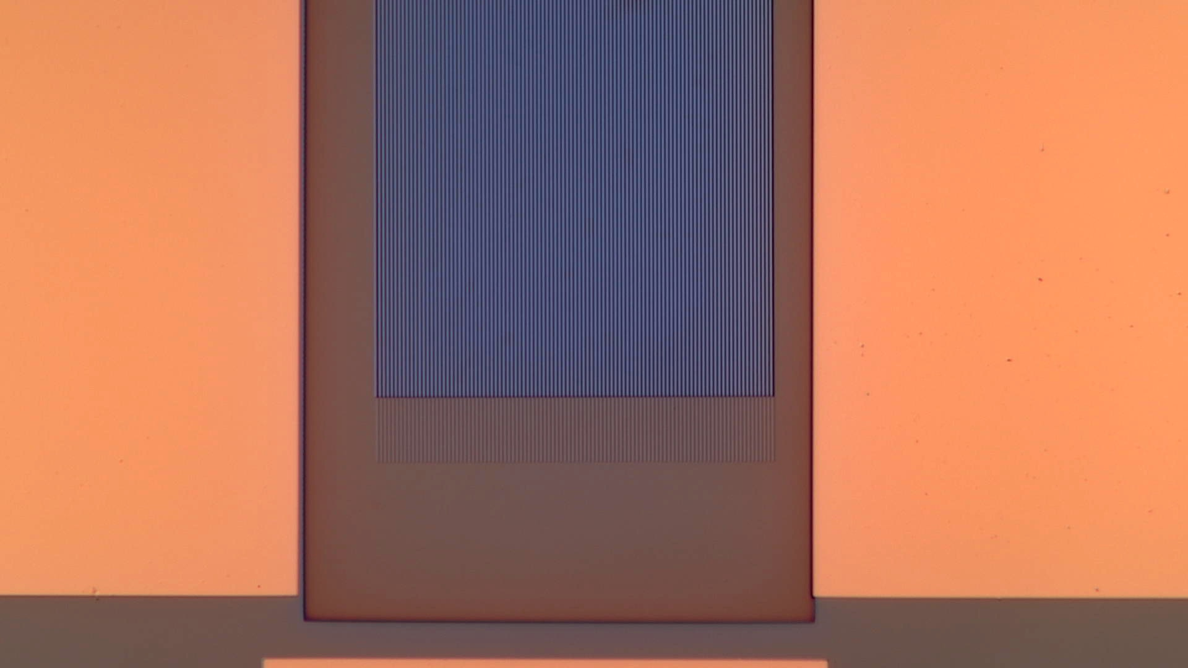
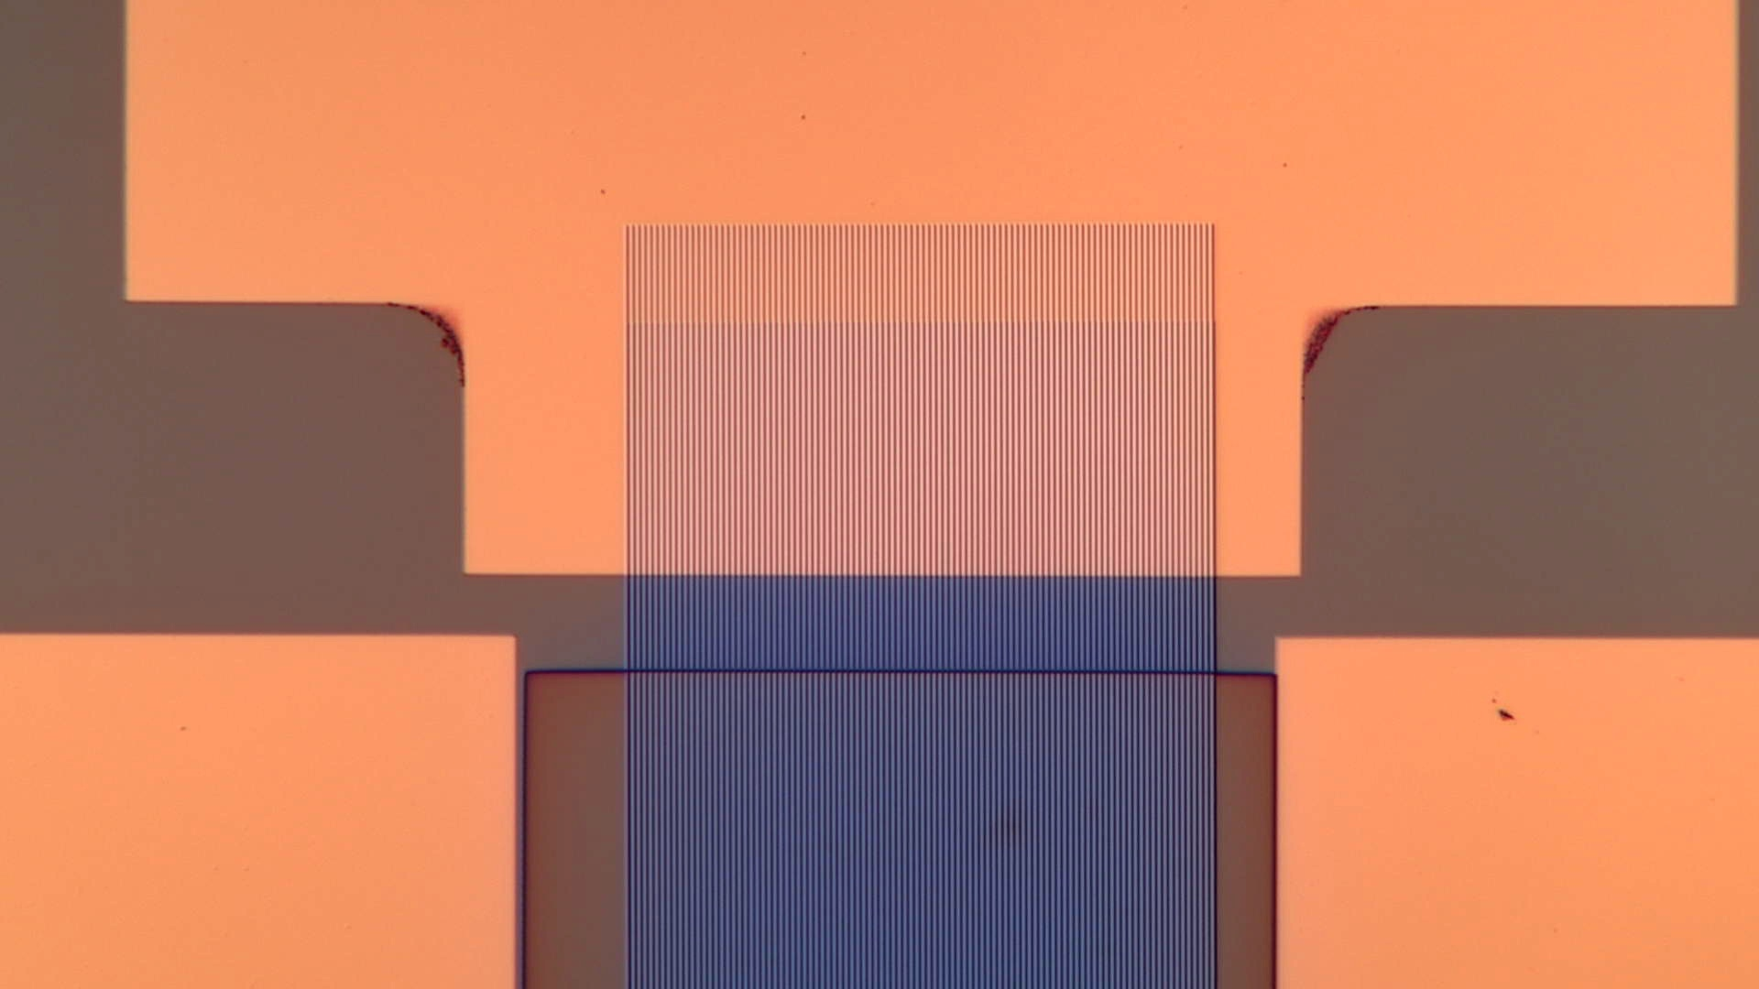
Potential Misalignment Issue
100 µm
Misalignment
14 µm
14 µm
Misalignment
Optical microscope images displaying alignment issues with gate array and recess
Device Failure

Slide 22
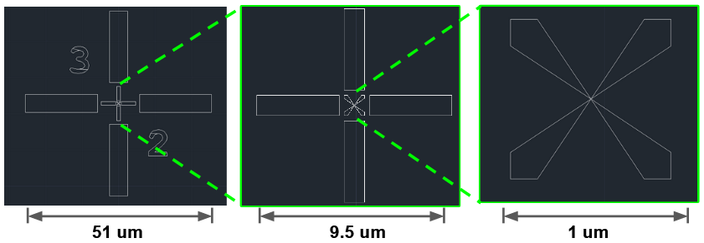
Accurate Alignment using Pre-fabricated Markers
6 X 6 Matrix of Markers (500 um apart)

Slide 23
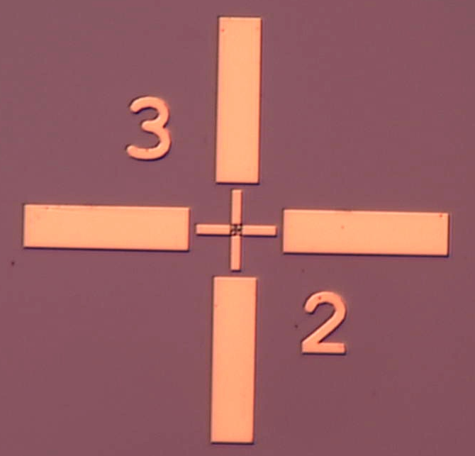
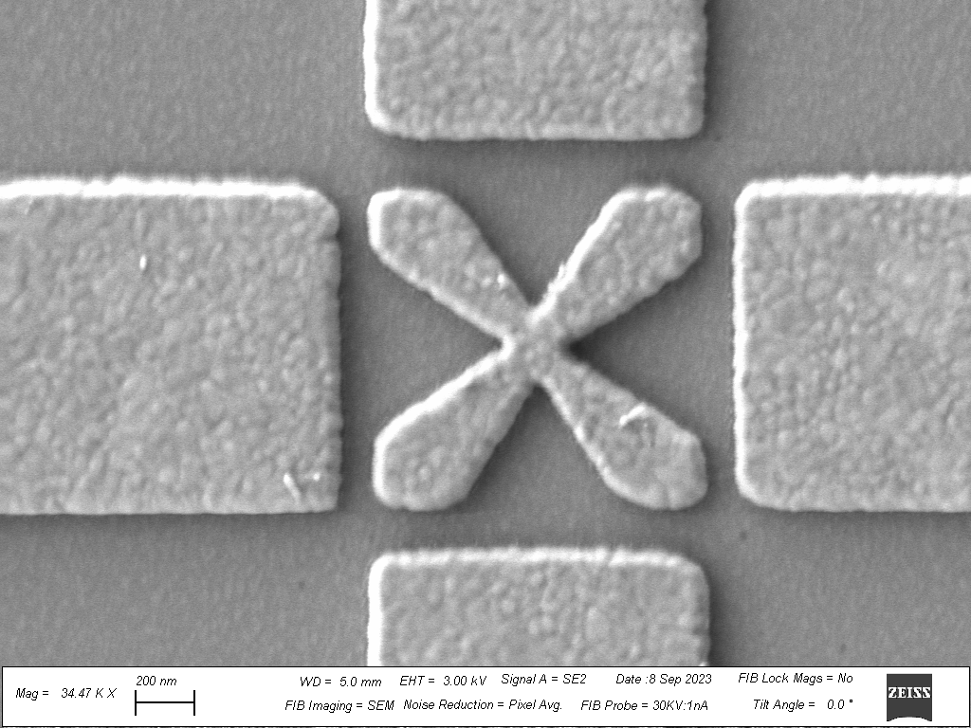
Step 1 and 2: Results
500 nm
5 µm
100X
The optical microscope image of a marker with 100x magnification
SEM image of a marker center

Slide 24
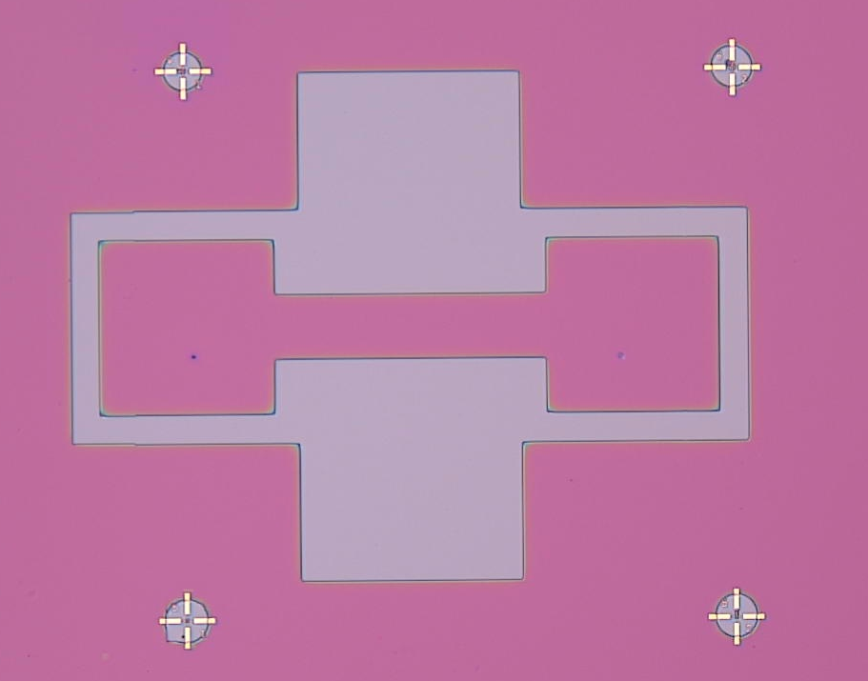
Step 3: Mesa Isolation Exposure
EBL Parameters
Field Size | 500 um
Exposure Current | 20nA
Exposure Dose | 1000 uC/cm²
Number of Dots | 50,000
Resist Layers/ Thickness | A4-A5/ 500 nm
60 µm
Development : 35 sec MIBK: IPA =1:3
10X
Optical microscope image of mesa exposure after development with 10x magnification

Slide 25
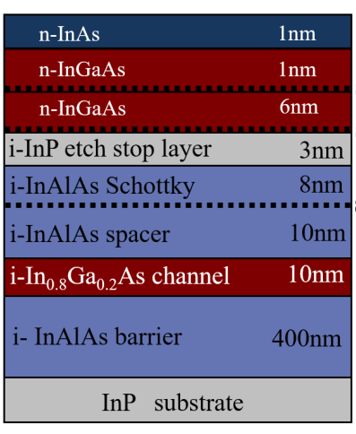
InP based InGaAs Heterostructure used in this work
Step 4: Wet Chemical Etching
Etching Parameters:
•The clean room temperature: 65.7⁰ F
•The speed of magnetic stirrer: 400 rpm
•Initial mixing time: 10 min
•Chemicals used:
1. Phosphoric acid (H₃PO₄) 85+% solution in water
2. Hydrogen peroxide (H_{2­}O₂) 30%
3. Deionized Water (H₂O)
•Ratio used: 1:1:40
•Amount used: 3 ml : 3 ml : 120 ml •Etching time: 125 seconds.

Slide 26
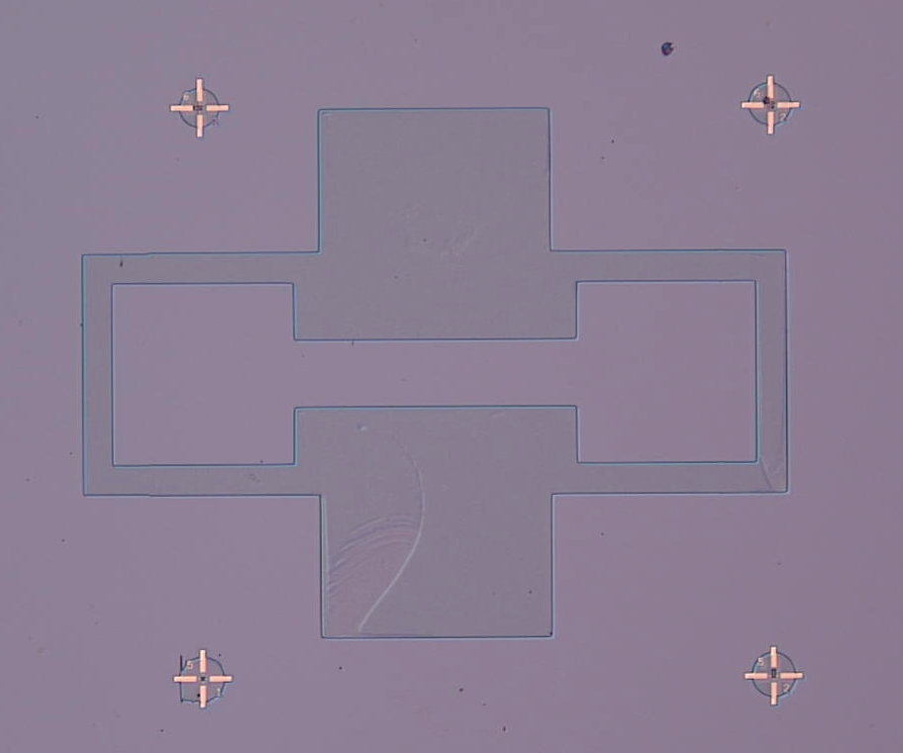
Step 4: Mesa Etching
Step 5: Citric Acid Etching
Result
Optical microscope image after mesa etch and citric acid etching with 10x magnification
60 µm
10X
Note: It can be seen that the bottom surface after the etching process is not uniform at some regions. However, the isolation still holds true, as evident after etch depth measurement.

Slide 27
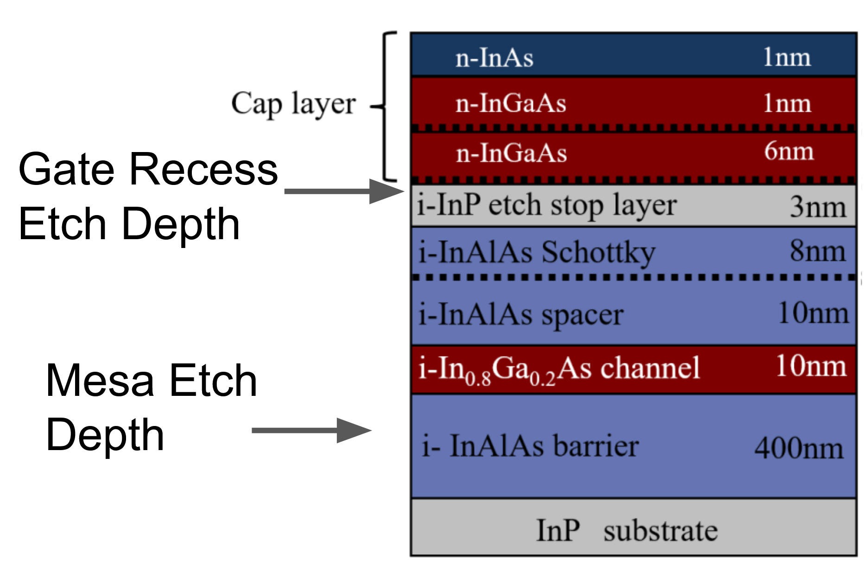
Optical microscope image after recess exposure
Step 6: Gate Recess Exposure
Conducting
60 µm
10X

Slide 28
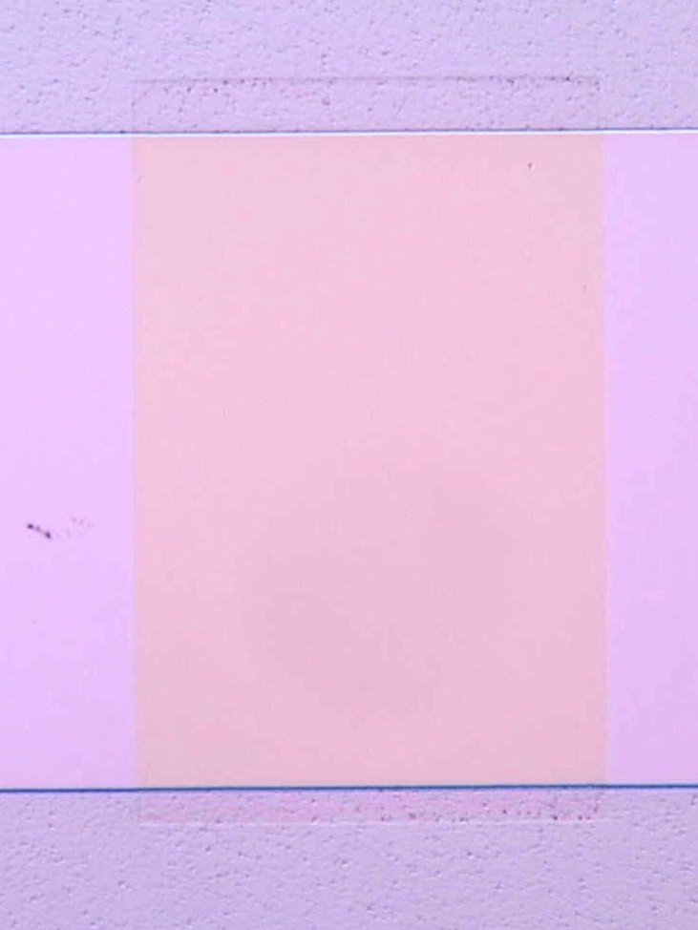
Step 7: Gate Recess Etch
Similar etching recipe used from step 4 except for the etching time.
Etching Time = 15s
Optical microscope image after gate recess etching
Etched
4 µm
100X

Slide 29
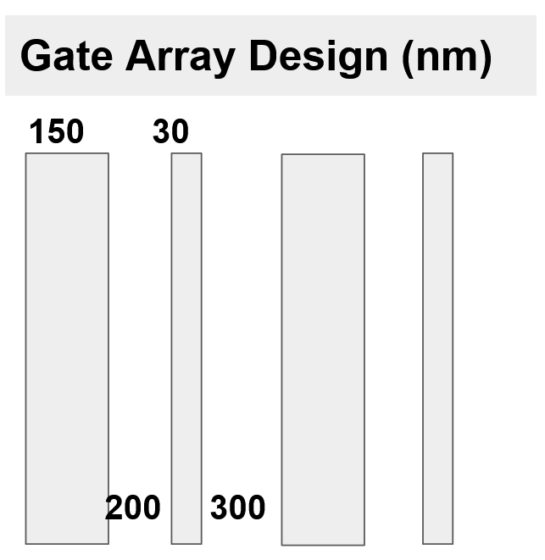
Step 8 and 9: Asymmetric Gate Array Exposure, Metal Deposition, and Liftoff
EBL Parameters
Field Size | 500 um
Exposure Current | 100pA
Exposure Dose | 820 uC/cm²
Number of Dots | 1,000,000
Resist Layers/ Thickness | A4-A2/ 250 nm
Development : 35 sec MIBK: IPA =1:3

Slide 30
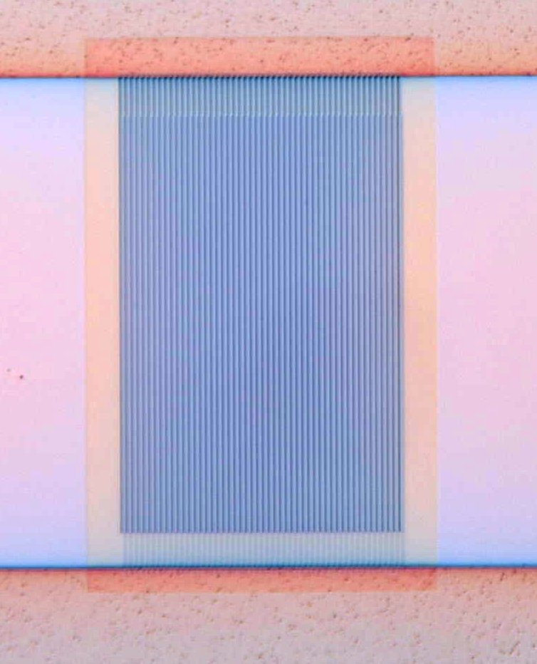
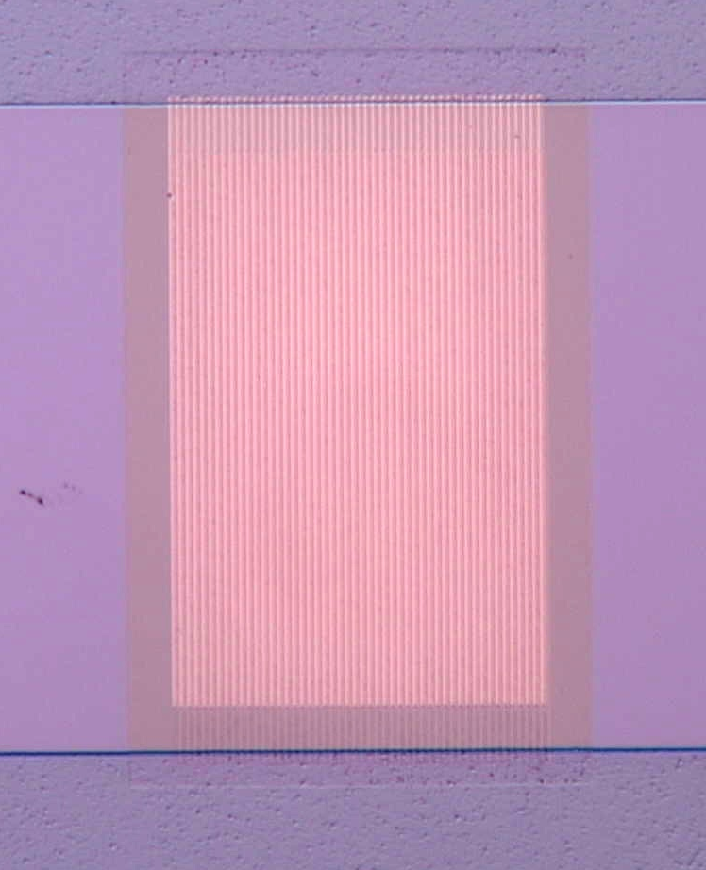
Step 8 and 9: Results
Optical microscope images after gate array exposure (Left) and after metal liftoff (Right)
(Metal deposited
Cr/Au:5/25 nm)
4 µm
4 µm
100X
100X

Slide 31
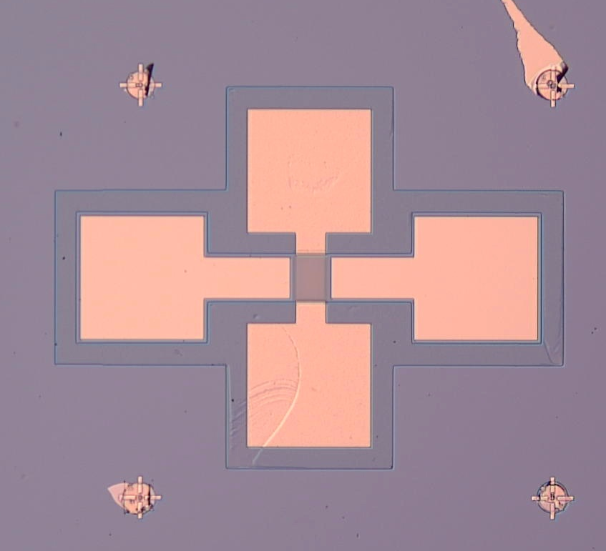
Step 10 and 11: Results
150 µm
25 µm
10X
50X
On the left is a 10X optical-microscope image of our plasmonic gate array device, after the last step in the process flow i.e., after the contact pad metal deposition (Cr/ Au: 10/ 150 nm) and lift-off. The figure on the right is a 50X optical-microscope image of the center part of our plasmonic gate array device.

Slide 32
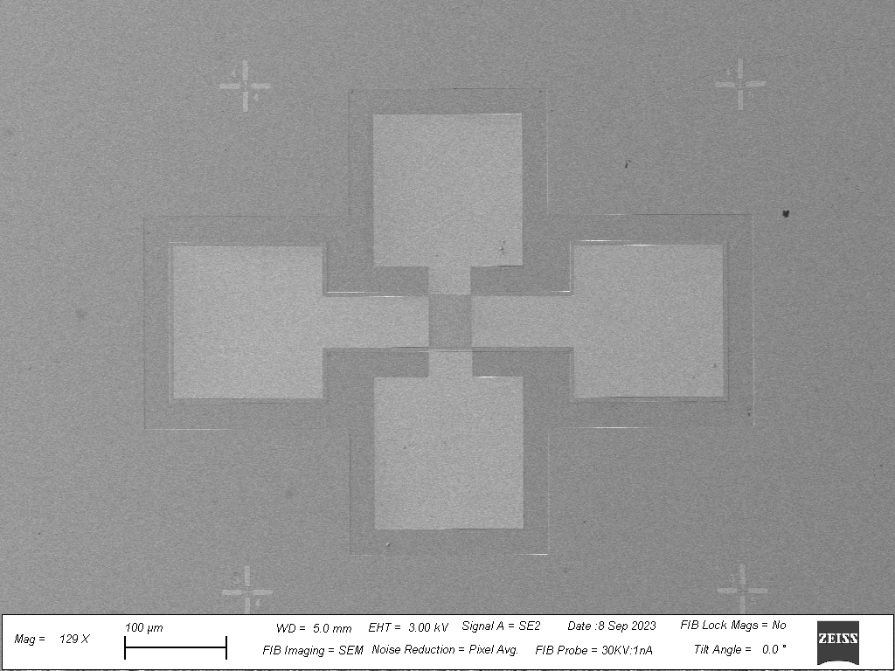
Practice device
inspection using SEM
100 µm

Slide 33
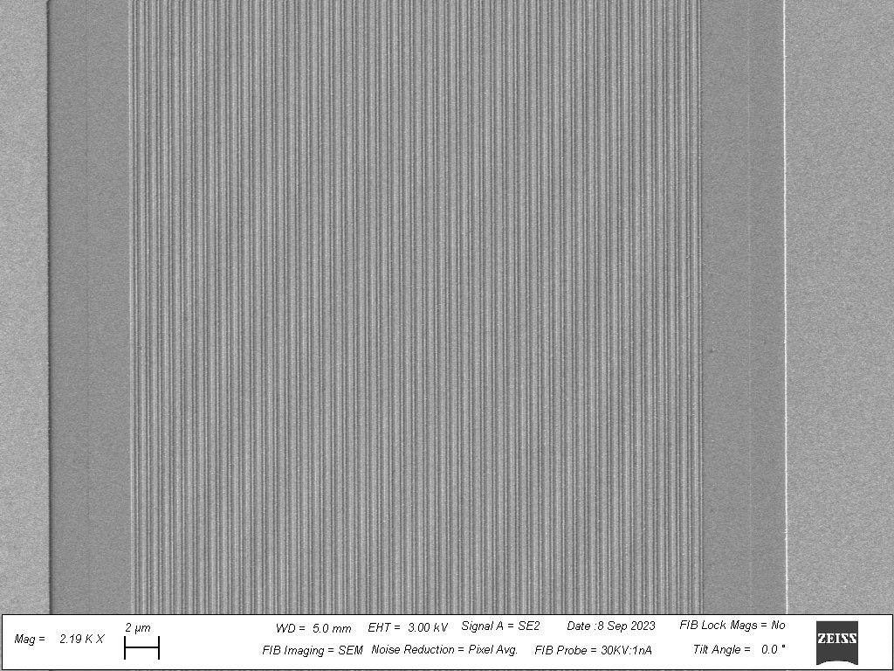
Practice device
inspection using SEM
2 µm

Slide 34
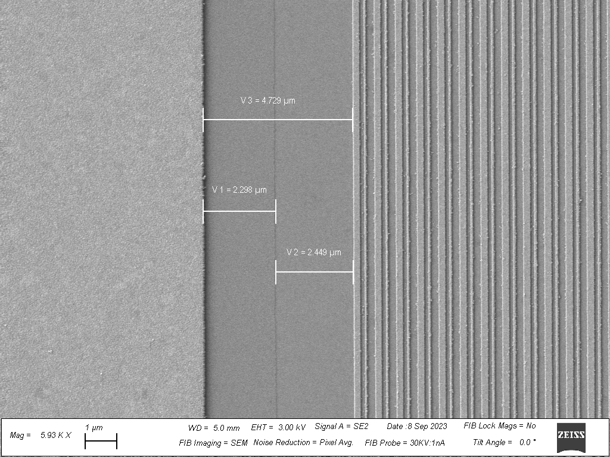
Practice device
inspection using SEM
1 µm

Slide 35
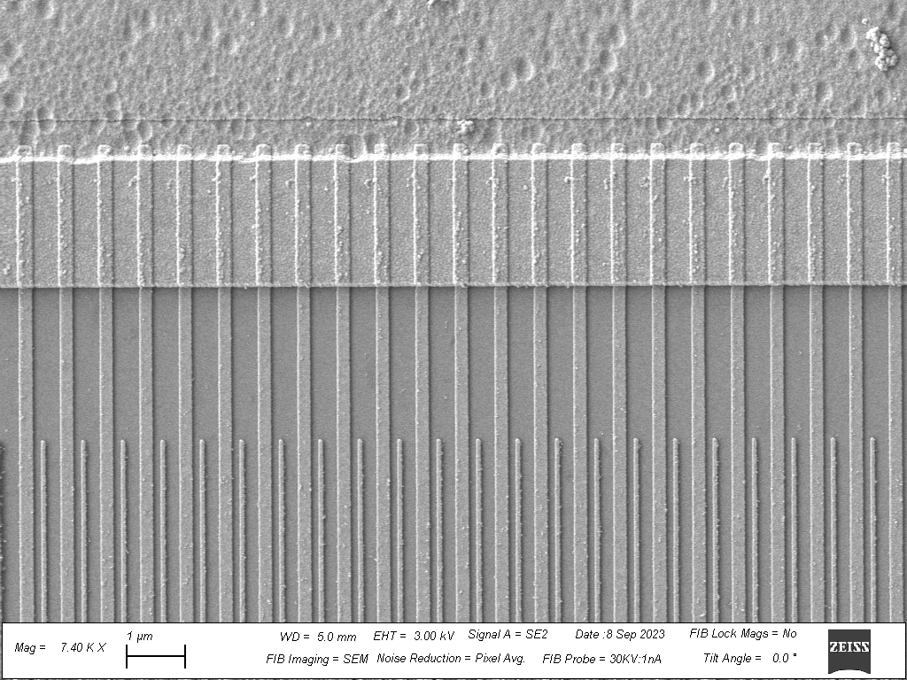
Practice device
inspection using SEM
1 µm

Slide 36

Practice device
inspection using SEM

Slide 37
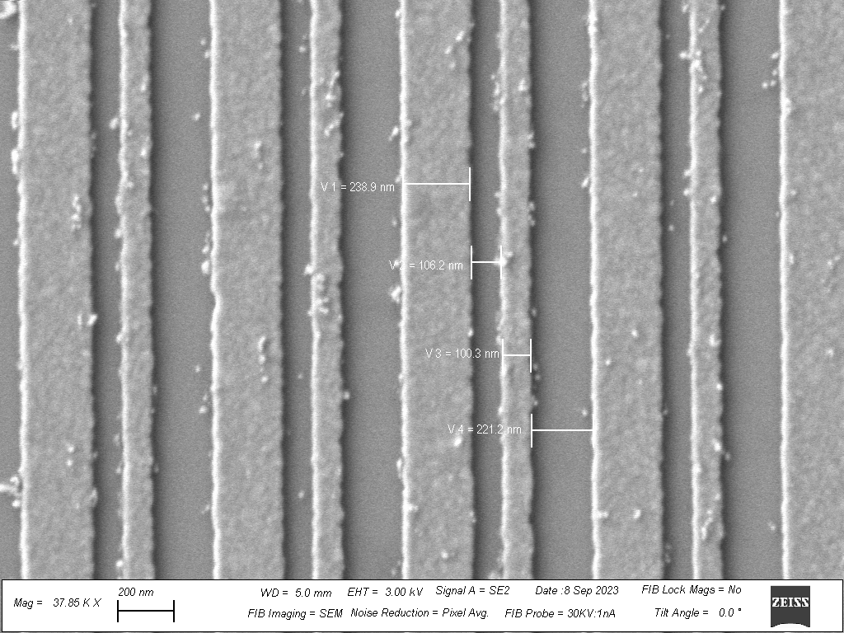
Practice Device Inspection
using SEM
200 nm

Slide 38
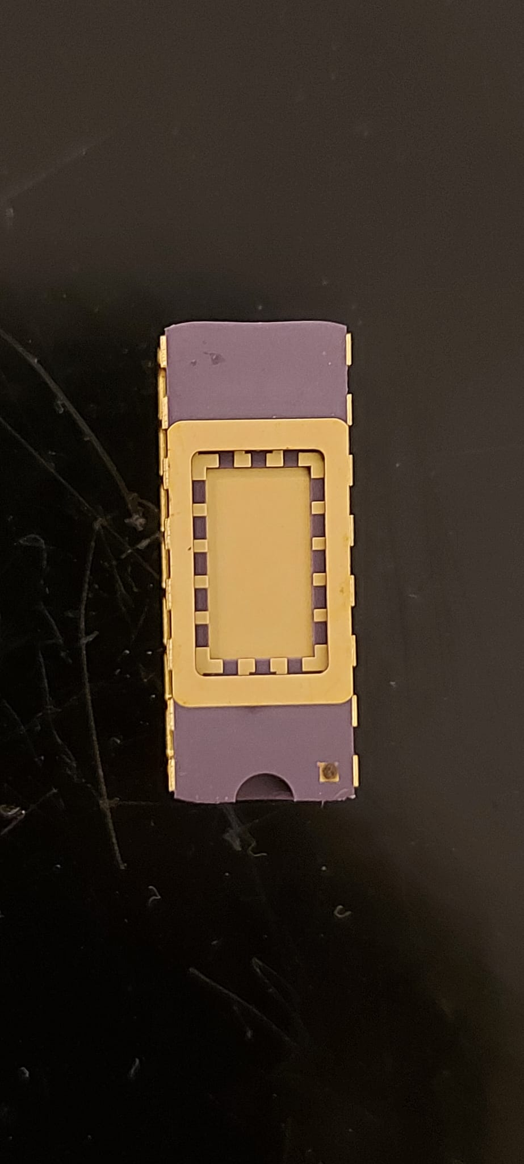



Wire Bonding
8 x 5 mm

Slide 39
Next Steps
Perform electrical testing on the fabricated devices, and measure transistor performance.
Systematic analysis of gate array design on plasma wave growth.
Comprehensive device characterization, involving measurements for contact resistance (TLM measurements), mobility, mean free path, electron density (Hall bar measurements)

Slide 40
Paper and Conference Presentations
B. Barut, X. Cantos-Roman, J. Crabb, A. Mundaganur, S. Mundaganur, T. Sugaya, E. Einarsson, J.M. Jornet, J.P. Bird, and G.R. Aizin, “Asymmetrically engineered nanoscale transistors for on-demand sourcing of terahertz plasmons”, contributed talk, the 22nd International Conference on Electron Dynamics in Semiconductors, Optoelectronics and Nanostructures (EDISON22), Munster, Germany, August 14th – 18th, 2023.
G. Aizin, S. Mundaganur, A. Mundaganur, and J. P. Bird, “Terahertz-frequency plasmonic-crystal instability in field-effect transistors with asymmetric gate arrays”, submitted for publication.
A. Mundaganur and S. Mundaganur, and J.P. Bird, “Asymmetrically engineered nanoscale transistors for on-demand sourcing of terahertz plasmons”, poster presentation, Workshop on Innovative Nanoscale Devices and Systems (WINDS 2023), Hawaii, USA, December 3rd–8th, 2023.

Slide 41
THANK YOU!

Slide 42
Supplementary Slides

Slide 43

THz Devices
T. Otsuji, M. Shur, IEEE Microwave Magazine, Volume:15, Issue:7, Nov.-Dec. 2014

Slide 44
Communication Bands
Frequency Type | Frequency Range | Common Uses
Very High Frequency | 30 MHz to 300 MHz | FM radio, television broadcasting, mobile radio, air traffic control
Ultra-high Frequency | 300 MHz to 3 GHz | Mobile networks (4G), Wi-Fi, Bluetooth, GPS
Super High Frequency | 3 GHz to 30 GHz | Satellite communications, Mobile networks (5G)
Extremely High Frequency | 30 GHz to 300 GHz | Radio astronomy, remote sensing, research and development

Slide 45
Dyakonov- Shur Instability experiments and their limitations
      Physically shorting the source to the gate and driving the transistor into saturation.
Customized HEMT designs in which the gate was positioned closer to the source than the drain were fabricated.
      Precise placement of nanoscale gate near etched trench at the drain side of the plasmonic device. (Research done in our lab)
Boundary conditions satisfied for DS instability.
Still, the radiated power was expected to be very weak (~nW) for practical applications.

Slide 46

Alignment Achievement Using Marker Design
Total marker alignment process count = 4 (Step 3,6,8, and 10)
Alignment tolerance threshold achieved ~ 20nm
Example:

Slide 47

Step 5: Citric Acid Etching
Etching Parameters:
•The clean room temperature: 65.7⁰ F
•The speed of magnetic stirrer: 400 rpm
•Initial mixing time: Until Citric Acid dissolves completely
•Chemicals used: 1. Citric acid (C₆H₈O₇)
2. Hydrogen peroxide (H_{2­}O₂) 30%
3. Deionized Water (H₂O)
•Ratio used: - 2gr : 1ml : 2ml
•Amount used: - 20 gr : 10 ml : 20 ml
•Etching time: 60 seconds.

Slide 48
Step 10 and 11: Contact Pads Pattern Exposure, Metal Deposition, and Liftoff
EBL Parameters
Field Size | 500 um
Exposure Current | 20nA
Exposure Dose | 1000 uC/cm²
Number of Dots | 50,000
Resist Layers/ Thickness | A4-A5/ 500 nm
E beam Evaporator Parameters
Vacuum Pressure | 5E-7 Torr
Bottom Layer Deposition Rate | 0.5 Angstrom/s
Top Layer Deposition Rate | 0.8 Angstrom/s
Bottom Layer Metal Film | Cr (10 nm )
Top Layer Metal Film | Au(150 nm)
Development : 35 sec MIBK: IPA =1:3

Slide 49

Practice device
inspection using SEM
2 µm

