Slide 1
High-Energy-Density
All-Solid-State Batteries with Sulfur-Based Electrolytes
Mini-Conference
Engineering Nano-Scale Structures for Advanced Applications
Hedi Yang & Jaehee Park
PI: Prof. Ying Shirley Meng
05/10/2024

Slide 2


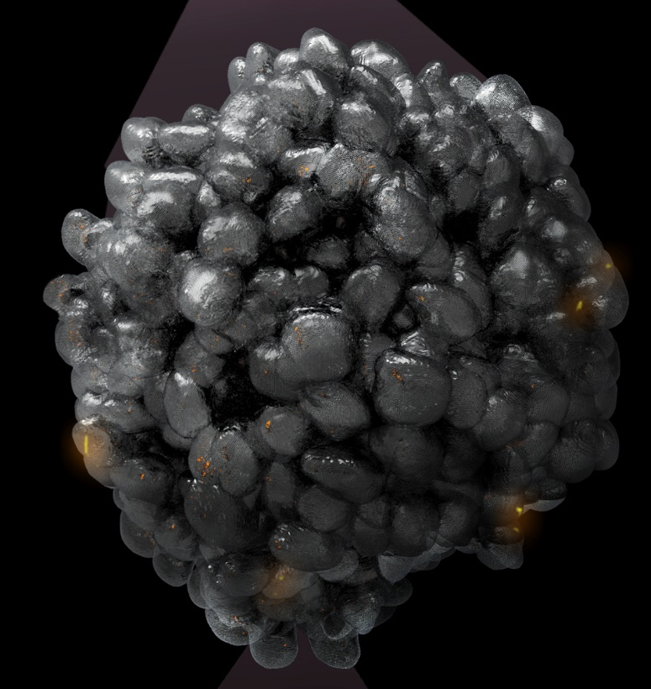

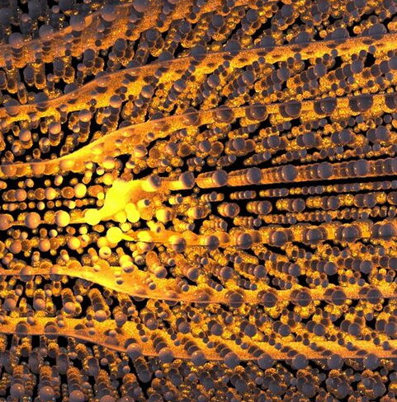
Atom to System - Build Talents, Ideas and An Ecosystem
Workforce from Meng Group
2010 – 2023
30 + 9 Postdoctoral
40 + 20 Ph.D.
14 + 1 Master
23 + 6 Undergraduate
Science 2015
Science 2017 (South 8 Technologies, Inc)
Nature Energy 2018
Joule 2018, 2020
Nature 2019
Nature Nanotechnology 2020 (Unigrid, Inc)
Nature Materials 2020
Nature Energy 2021
Science 2021
Joule 2022 (ExPost Technologies Inc.)
Nature Nanotechnology 2023
Funded by
US Department of Energy (2010 – present)
US National Sciences Foundation (2010 – present))
EFRC – NCCESS (2010-2020)
Battery500 (2016 – present)
LGES Frontier Research Laboratory (2021 – present)
Various Industrial Partners including
(LG Energy Solution / ThermoFisher Scientific / Shell / UL /Nissan /Cummins/ SES/ Supernal /GM / Applied Materials)
Three Spun Out Startup Companies
Eight Issued Patents and Ten Pending
Electronic-level
Electrode-level
20 μm
Atomic-level
Meso-structure-level
Single Particle-level
Notes:
Dr. Y. Shirley Meng is a Professor at the Pritzker School of Molecular Engineering at the University of Chicago. She serves as the Chief Scientist of the Argonne Collaborative Center for Energy Storage Science (ACCESS) Argonne National Laboratory. Dr. Meng is the principal investigator of the research group - Laboratory for Energy Storage and Conversion (LESC), that was established at University of California San Diego since 2009. She held the Zable Chair Professor in Energy Technologies at University of California San Diego (UCSD) from 2017-2022. Dr. Meng received several prestigious awards, including ECS Battery Division Research Award (2023), the C3E technology and innovation award (2022), the Faraday Medal of Royal Chemistry Society (2020), International Battery Association IBA Research Award (2019), Blavatnik Awards for Young Scientists Finalist (2018), C.W. Tobias Young Investigator Award of the Electrochemical Society (2016) and NSF CAREER Award (2011). Dr. Meng is elected Fellow of Electrochemical Society (FECS), Fellow of Materials Research Society (FMRS) and Fellow of American Association for the Advancement of Science (AAAS). She is the author and co-author of more than 300 peer-reviewed journal articles, two book chapters and eight issued patents. She is the Editor-in-Chief for Materials Research Society MRS Energy & Sustainability. Dr. Meng received her Ph.D. in Advance Materials for Micro & Nano Systems from the Singapore-MIT Alliance in 2005. She received her bachelor’s degree in Materials Science with first class honor from Nanyang Technological University of Singapore in 2000

Slide 3
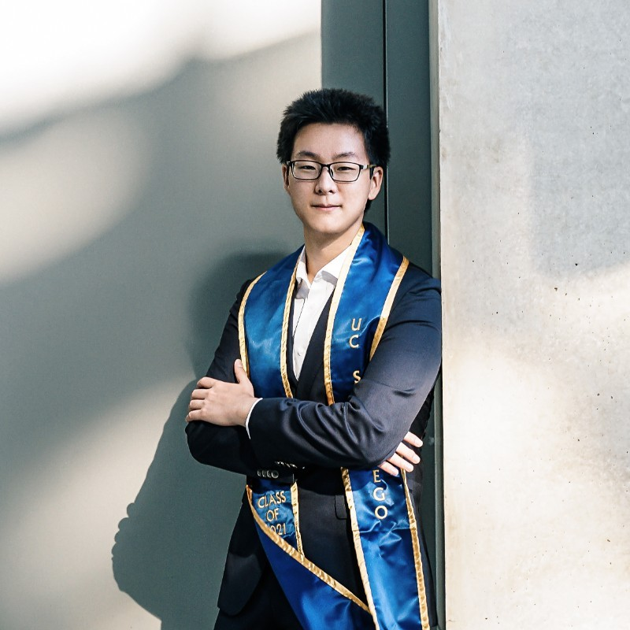

Project Members
Hedi Yang
2nd year graduate student at the Pritzker School of Molecular Engineering (PME) at the University of Chicago
Yang has been a member of Meng group since his undergraduate and Master’s studies at UCSD and is trained extensively on the basic techniques and procedures of solid-state battery materials. Yang’s contributions in Dr. Darren Tan et al.’s article¹ on carbon-free Si anodes for solid-state batteries provides him with sufficient theoretical and practical knowledge on the topic.
Jaehee Park
1st year graduate student at the Pritzker School of Molecular Engineering (PME) at the University of Chicago
Park has been a member of the Meng group, bringing her solid-state battery expertise developed during her master‘s studies at Kyoto University and further honed through her work on lithium dendrite challenges. Her proficiency is highlighted by her research using operando X-ray computed tomography, notably published² in this field. At Meng group, Park has been extensively trained in both sulfide and halide-based SSE materials, building on a strong foundation in material synthesis—covering solid-state electrolytes, sulfur/Li₂S-based cathodes, and micro-Si anodes—and basic electrochemical characterization of LiIn-Li₂S cells.
¹Science 373.6562 (2021): 1494-1499.; ²Chem. Commun., 2023, 59, 7799

Slide 4
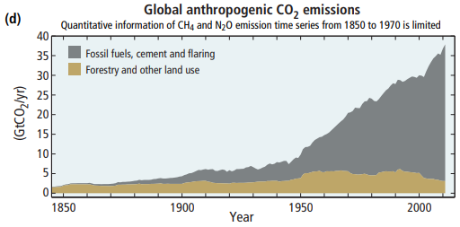

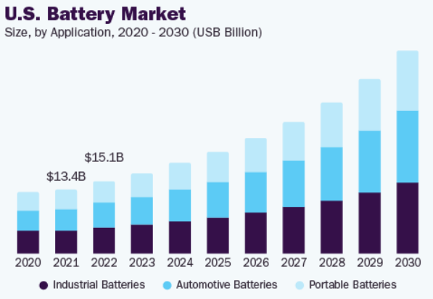



Growing Demand for High-Capacity Batteries
Global CO₂ emissions driven by economic and population growth ( > 40 Gt CO₂/yr)
Projected increase in electricity demand ( > 1000 TWh)
Electric vehicles and renewable energy push for better batteries
Reliability of renewables
Increase renewable fuel share
Electrification for efficiency
IPCC, 2014: Climate Change 2014: Synthesis Report, U.S. Battery Market Size And Share, Industry Report, 2030

Slide 5
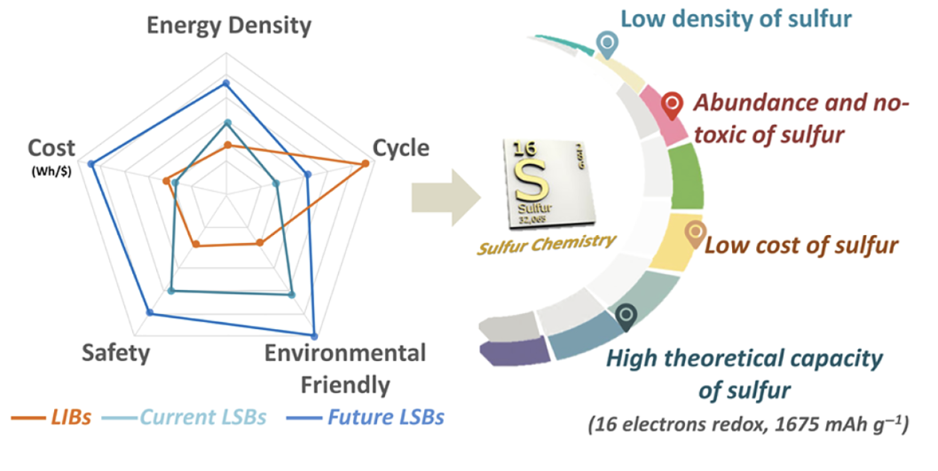
Advantages of Conversion-Type Li-S Batteries
Li-S batteries can cause a paradigm shift for currently inaccessible technologies
Parameter | Intercalation-Type Cathodes | Conversion-Type Cathodes
Reaction Mechanism | Ion insertion into layered structure | Full material transformation
Energy Density (Wh/kg) | Up to 260 | Up to >260*, conditional
Theoretical Capacity (mAh/g) | 100-265 | 500-1675
Cost Effectiveness | Moderate | Potentially lower, abundant sulfur
Example | Commercialized cathode LiCoO₂ | S, FeF₂
Why Sulfur?
10th most abundant
Note: *It can with specific conditions such as lean electrolyte, high areal capacity, and high sulfur loading.
InfoMat. 2022 4(9), e12359; Adv. Mater. 2020, 2003955

Slide 6
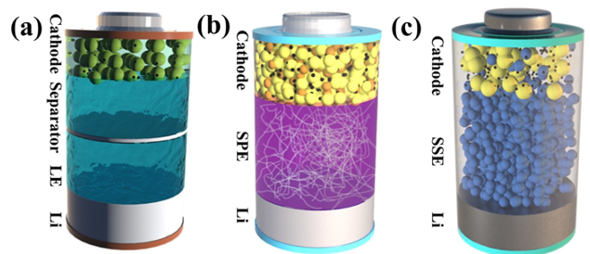
Impact of Electrolyte Evolution on Battery Performance
Multi-step conversion
1st stage: S₈→Li₂S_{n}
(2.2 to 2.3 V)
2nd stage: Li₂S_{n} → Li₂S
(2.0 to 2.1 V)
Soluble lithium polysulfides
Shuttle effect
Electrolyte leakage
Dendrite growth
Reliance on solid-solid contact
Ionic/electronic conduction
(Electro)chemical stability
Mechanical properties
Liquid electrolyte Solid-state electrolyte
Mater. Chem. Front., 2023, 7, 5760–5785

Slide 7
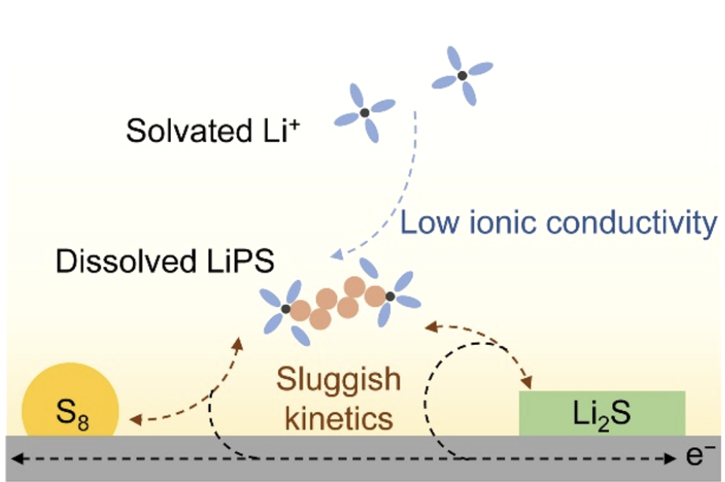
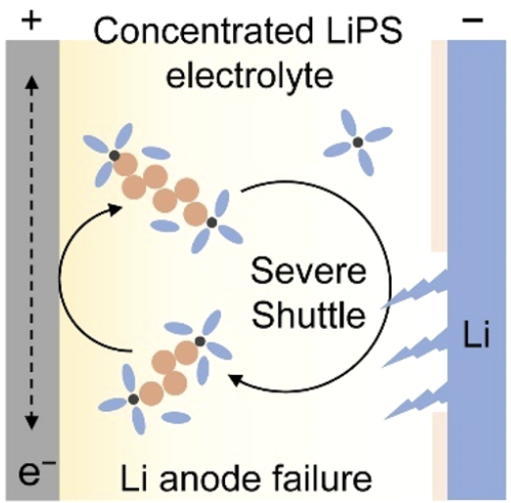
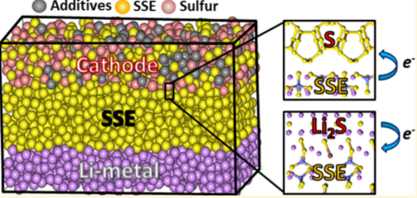
All-Solid-State Battery: Solution for Polysulfide Dissolution
Bottlenecks of liquid Li-S
Polysulfide dissolution
Insulative properties
Sluggish kinetics
Benefits of solid electrolyte
Resolve polysulfide dissolution
Inert against chemical degradation by polysulfides
Structural integrity
ACS Cent. Sci. 2020, 6, 7, 1095–1104; Chem. Mater.2020, 32, 360−373

Slide 8
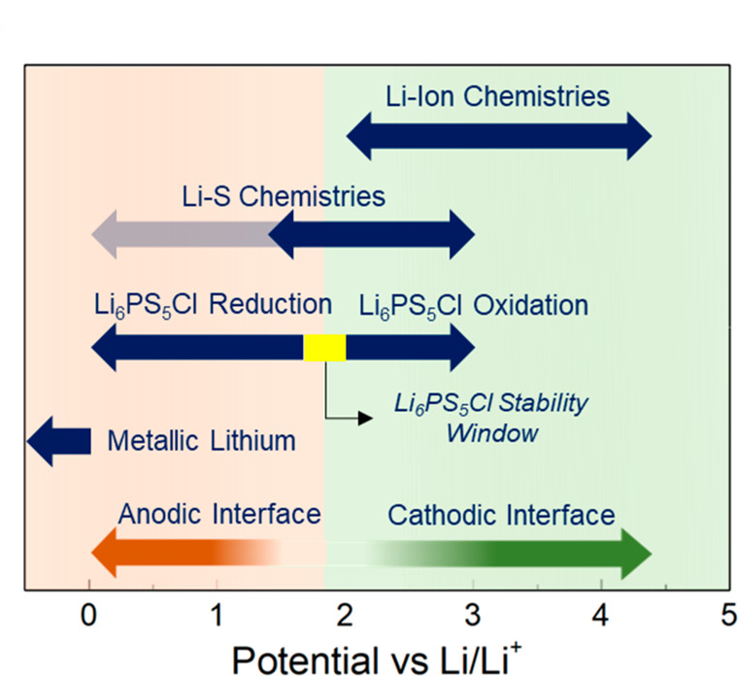
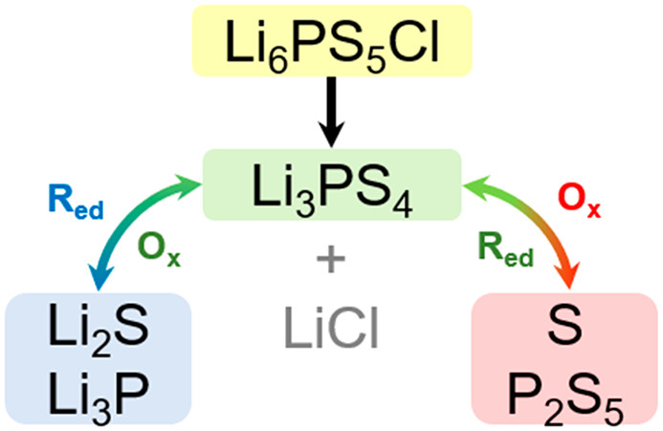
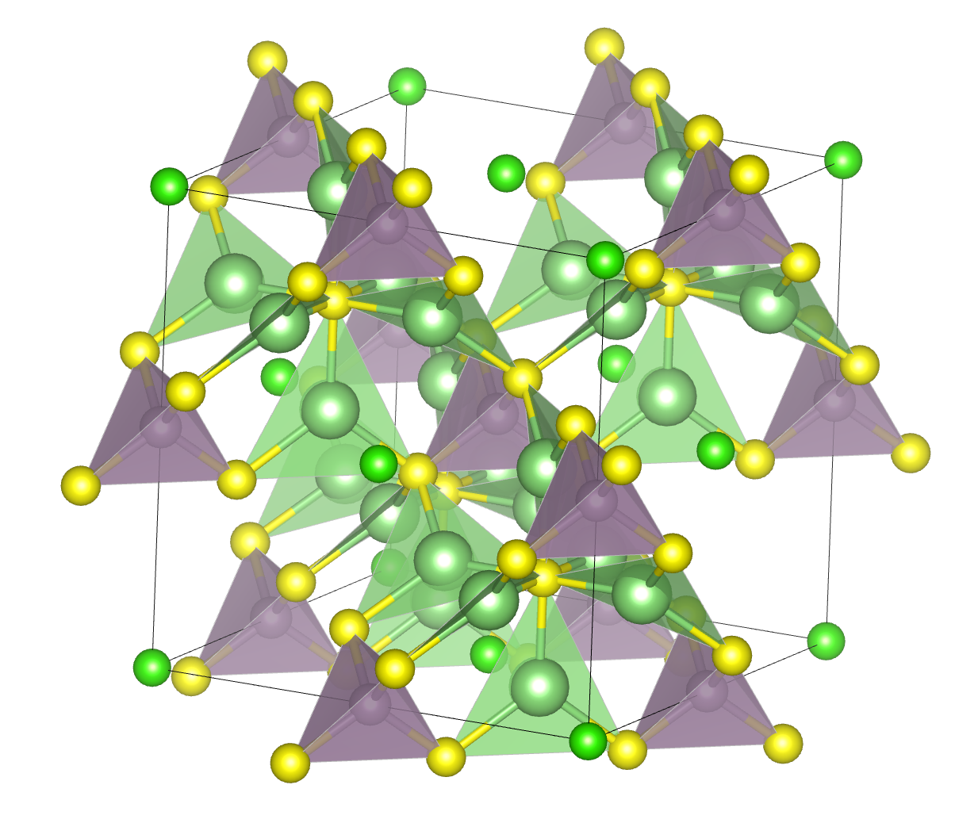
Benefits of LPSCl in Solid-State Li-S Batteries
Lithium
Phosphorous
Sulfur
Chlorine
Li₆PS₅Cl (LPSCl)
High ionic conductivity (>1 mS/cm at RT)
Provides ionic conduction pathways
Suitable voltage window (~2 V vs. Li/Li+) for Li-S (2.1 -2.4 V)
Decomposition products are
Redox active (Reversible reaction)
Stabilize the cathodic interface
Advanced Energy Materials 10.1: 1903253; ACS Energy Lett. 2019, 4, 2418−2427

Slide 9
Research Statement (Second Year)
  This project aims to develop the conversion-based S cathode system to further improve the performance of next generation solid-state LIBs. The objective of the second year is to utilize the skills obtained prior such as
    Material synthesis
    Sample preparation & data analysis for novel characterization methods
    ASSB fabrication & cycling evaluation
  to evaluate & optimize the novel material system.

Slide 10
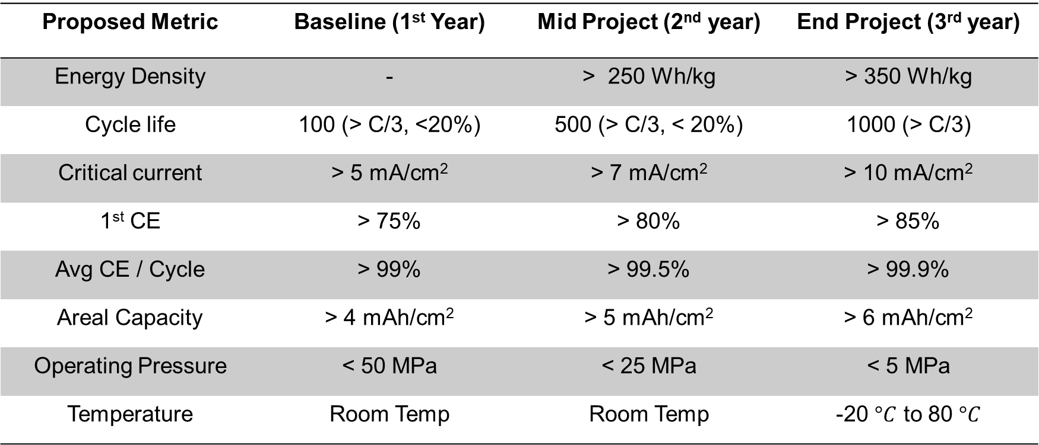
Research Statement (Second Year)
Proposed Metric | Baseline (1st Year) | Mid Project (2nd year) | End Project (3rd year)
Energy Density | - | > 250 Wh/kg | > 350 Wh/kg
Cycle life | 100 (> C/3, <20%) | 500 (> C/3, < 20%) | 1000 (> C/3)
Critical current | > 5 mA/cm² | > 7 mA/cm² | > 10 mA/cm²
1st CE | > 75% | > 80% | > 85%
Avg CE / Cycle | > 99% | > 99.5% | > 99.9%
Areal Capacity | > 4 mAh/cm² | > 5 mAh/cm² | > 6 mAh/cm²
Operating Pressure | < 50 MPa | < 25 MPa | < 5 MPa
Temperature | Room Temp | Room Temp | -20 $°C$ to 80 $°C$

Slide 11
Presentation Workflow
System Overview & Synthesis Procedure
Material Qualification & Characterization
Cycling Data

Slide 12
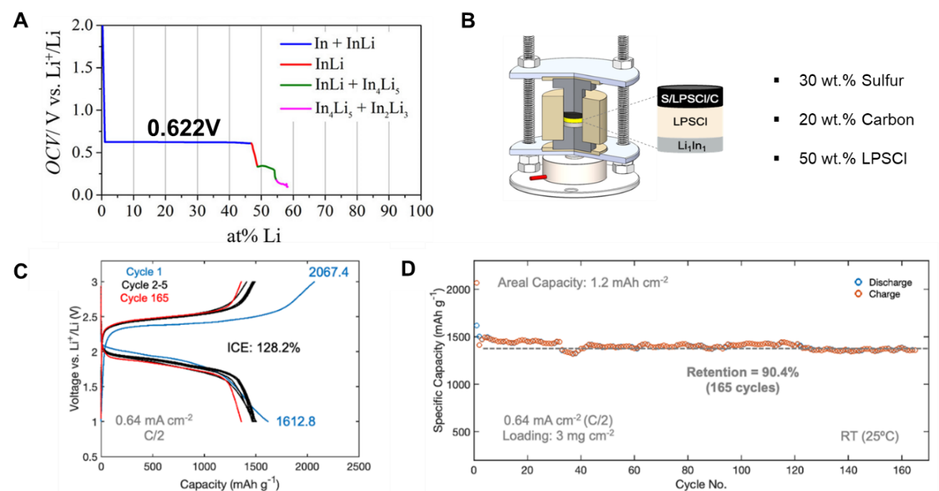

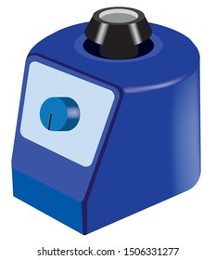
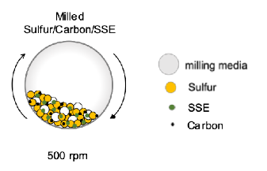
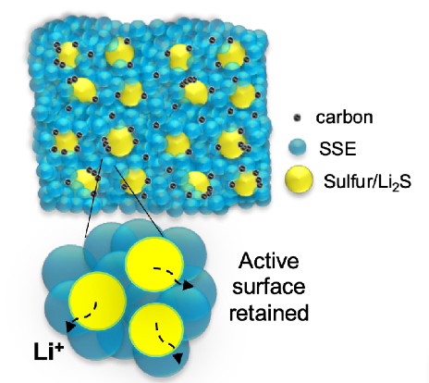
System Overview and Synthesis Procedure
One-step sulfur cathode composite synthesis
Li₁In₁ synthesis
Li + In = Li₁In₁
“Triple-phase contacts”
Reduce complexity
Enhances scalability
Retained active surface
SLMP
In Powder
Vortex-mixed until even
Batteries & Supercaps 2.6 (2019): 524-529.
Cell holder schematic
Sintering Pressure: 375 MPa
Stack Pressure: 75 MPa
Cathode Composite
Sulfur : LPSCL : Acetylene Black
30 wt% 50 wt% 20 wt%
Schematic & Procedural Credit: Ashley Cronk
Advanced Energy Materials 10.1 (2020): 1903253.

Slide 13
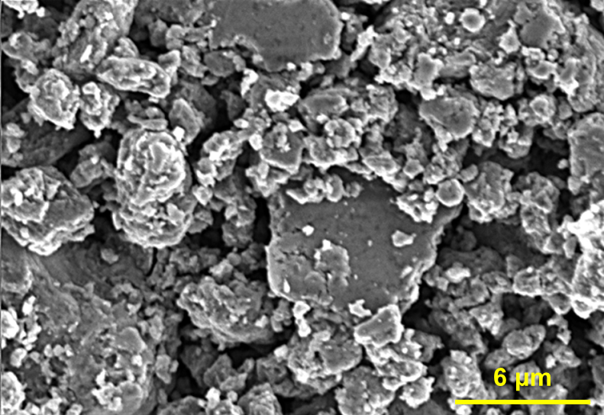
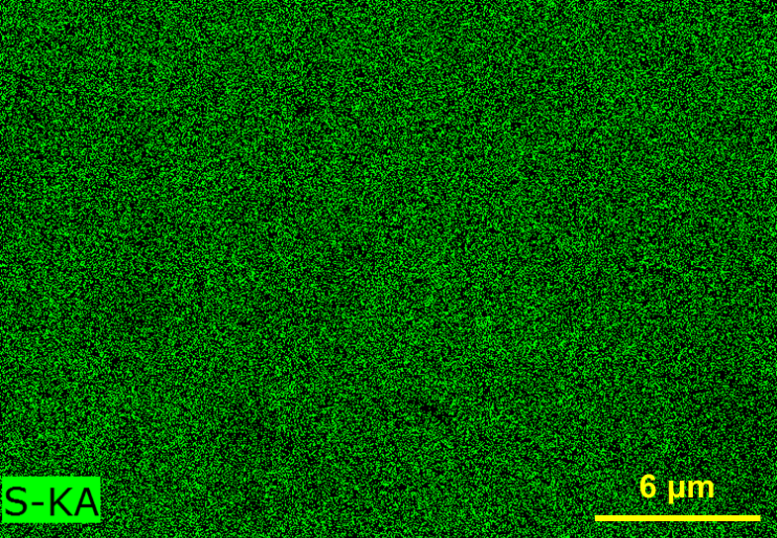
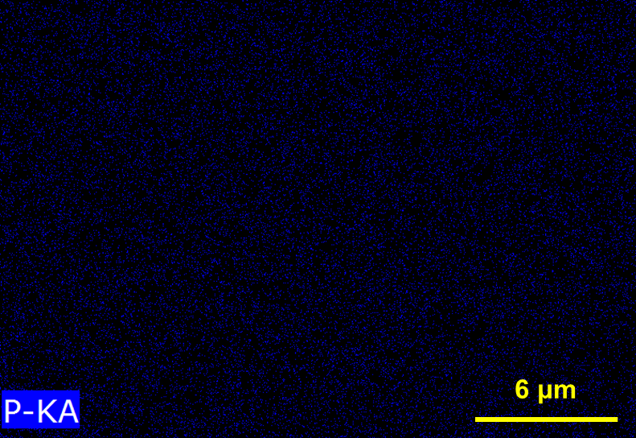
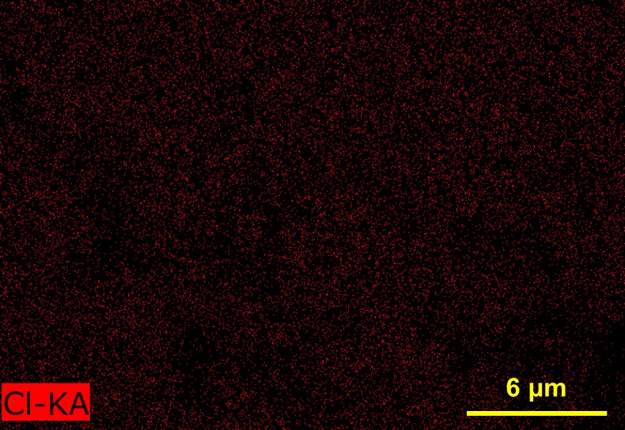
SEM & EDX to Probe Particle Morphology
Milled S Composite
+
+
=
SEM Stub
(Side View)
SEM Stub
(Top View)
Carbon
Tape
Powder
Sample
SEM
Sample
Composite components (LPSCl, S, C)
  Low/similar atomic mass nuclei
  Difficult to distinguish contrast
EDX also provide little information
  P & Cl distribution did not show discrete LPSCl vs S/C particles
Requires other methods of investigation
Sample prepared by Jerry Yang; Images collected by Dr. Sam Oh

Slide 14
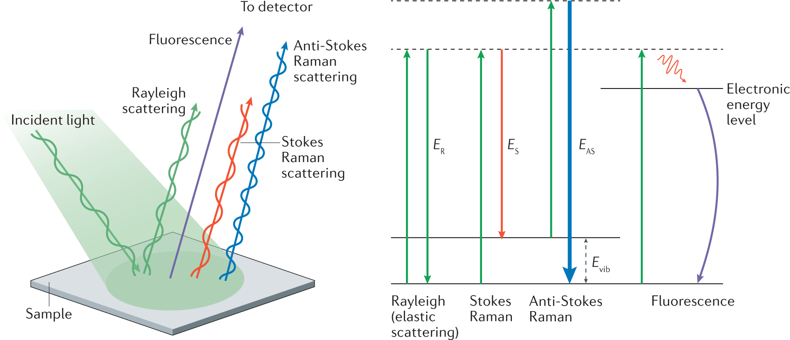
Raman Spectroscopy to Investigate Chemical Bonding
+
+
=
Cover
slide
Powder
sample
Kapton
Tape
Raman
Sample
Airtight Raman sample prepared using kapton tape and microscope cover slide
LPSCl clear PS₄³⁻ peak at 425.4 cm⁻¹
S Cathode Composite PS₄³⁻ contribution vanishes → reduction of symmetry
Shift in low wavenumber S peak
  red shift, indicates formation of polysulfidophosphates
Sample prepared by Jerry Yang; Spectra collected by Ashley Cronk
Nature Reviews Methods Primers 1.1 (2021): 21.

Slide 15
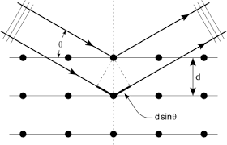

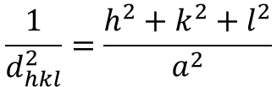

X-ray Diffraction to evaluate Crystallographic Information
$$\frac{1}{d_{hkl}^{2}}=\frac{h^{2}+k^{2}+l^{2}}{a^{2}}$$
$$\text{n}\text{λ}=2d sin\text{θ}$$
Bragg’s Law
Interplanar spacing for cubic system
Capillary Tube
Blow
Torch
Airtight XRD Sample prepared using Capillary tubes
LPSCl characteristic peaks
S characteristic peaks
S cathode composite
  Large amorphous hump from carbon contribution
  Signals from S & LPSCl characteristic peaks
+
=
+
=
Powder
sample
Temporarily Sealed Capillary
Capillary
XRD Sample
Sample prepared by Jerry Yang; Spectra collected by Phillip Ridley
X rays and crystal structure. Bell, 1915.

Slide 16

DC Polarization to probe electronic conductivity
Ti
$$σ=\frac{l}{RA}$$
V = IR
S Composite
Ti
Ohm’s Law
Conductivity Equation
Material | Resistance (Ω) | Electronic Conductivity (S/cm)
LPSCl | - | 4.95×10⁻⁹
S | - | 5×10⁻³⁰ (literature)
S Composite | 5.620 | 5.89×10⁻³
Used the low voltage stimulus of 30, 60, 90 mV to minimize electrochemical reaction between the materials
Incorporation of carbon in the composite significantly increase the electronic conductivity
ACS Sustainable Chemistry & Engineering 8.32 (2020): 12100-12109.

Slide 17
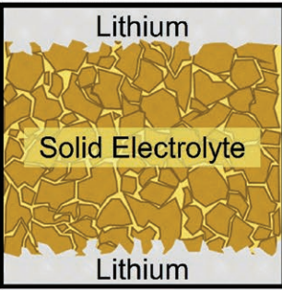

Cycling Evaluation of S Cathode vs Li₁In (1.6 mAh cm⁻²)
1.6 mAh/cm²
S Composite
Li₁In
Cell Type: Solid-state Half Cell
Cycling Protocol: 0.375V – 2.375V
Cathode Loading: 2.5 mg S Composite
Anode Loading: 50 mg Li₁In
Current Density: C/20
Operating Conditions: 100 MPa, RT
$CE=\frac{total charge during discharge}{total charge during charge} (\%)$
Capacity values exceeds theoretical values (1675 mAh g⁻¹)
  Electrolyte contributing to capacity
Single plateau reaction → different from liquid Li-S
Decrease in polarization after initial formation cycle
High capacity-retention at high C rates
Loading (mAh cm⁻²) | 1st DC (mAh/g) | 1st C (mAh/g) | ICE% | Conversion Efficiency
1.6 | 1549.2 | 1966 | 126.9% | 97.3%

Slide 18
Cycling Evaluation of S Cathode vs Li₁In (5.5 mAh cm⁻²)
S Composite
1.6 mAh/cm²
5.5 mAh/cm²
0.5677 V
0.6638 V
Li₁In
Li₁In
Cell Type: Solid-state Half Cell
Cycling Protocol: 0.375V – 2.375V
Cathode Loading: 9 mg composite
Anode Loading: 100 mg Li₁In
Current Density: C/20
Operating Conditions: 100 MPa, RT
Loading (mAh cm⁻²) | 1st DC (mAh/g) | 1st C (mAh/g) | ICE% | Conversion Efficiency | Polarization at 50% C/DC
1.6 | 1549.2 | 1966 | 126.9% | 97.3% | 0.5677 V
5.5 | 1446.1 | 1814.2 | 125.5% | 97.3% | 0.6638 V
Similar C/DC capacity value & curve shape
Increase in voltage polarization at 50% C/DC
Retain similar performance at >5 mAh/cm⁻²

Slide 19
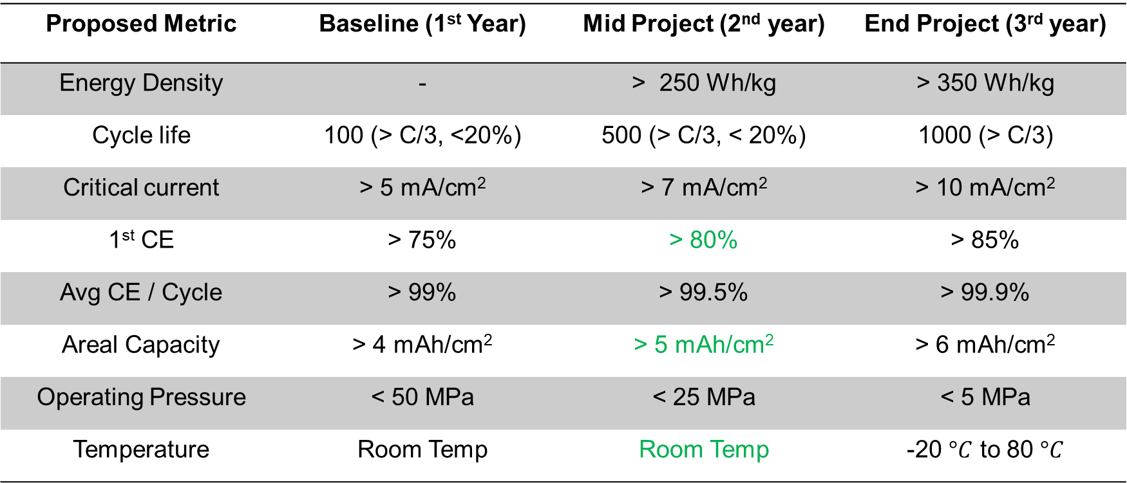
Research Baseline & Metrics
Proposed Metric | Baseline (1st Year) | Mid Project (2nd year) | End Project (3rd year)
Energy Density | - | > 250 Wh/kg | > 350 Wh/kg
Cycle life | 100 (> C/3, <20%) | 500 (> C/3, < 20%) | 1000 (> C/3)
Critical current | > 5 mA/cm² | > 7 mA/cm² | > 10 mA/cm²
1st CE | > 75% | > 80% | > 85%
Avg CE / Cycle | > 99% | > 99.5% | > 99.9%
Areal Capacity | > 4 mAh/cm² | > 5 mAh/cm² | > 6 mAh/cm²
Operating Pressure | < 50 MPa | < 25 MPa | < 5 MPa
Temperature | Room Temp | Room Temp | -20 $°C$ to 80 $°C$

Slide 20
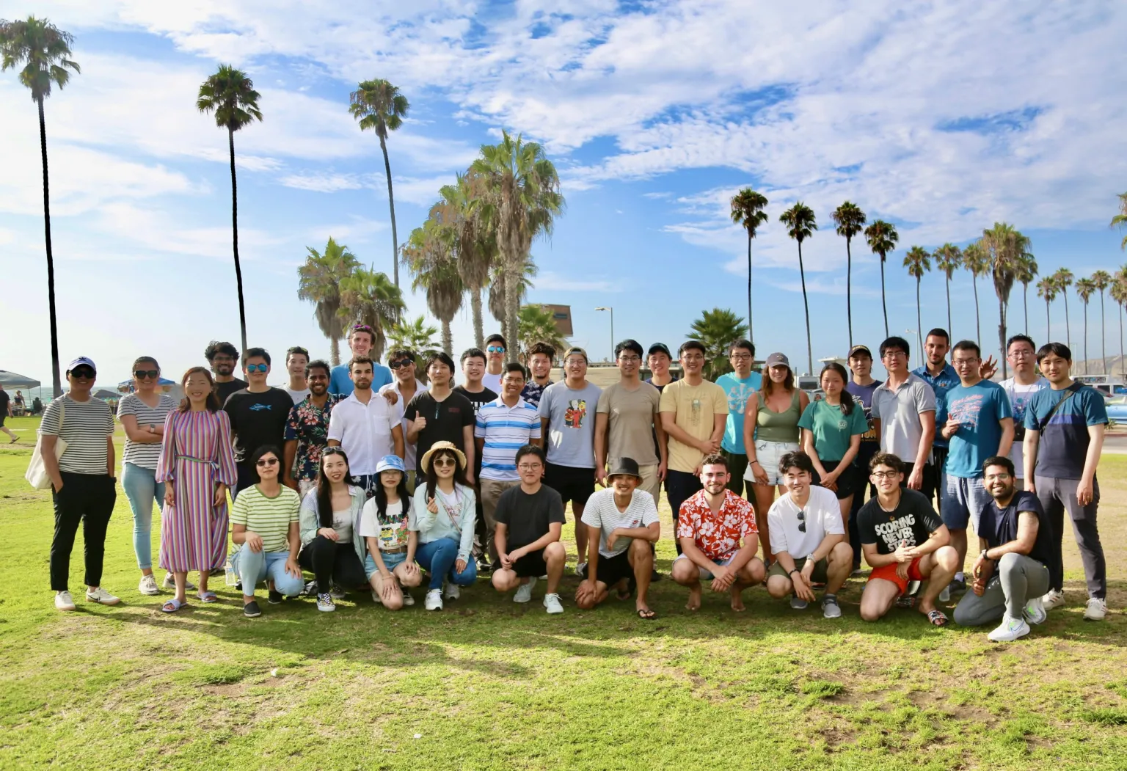



Acknowledgements
II-VI Foundation
The work was initiated in the collaboration project with LGES with two patents pending
Paper Submission
  Cronk et al., A highly utilized and practical lithium sulfur cathode realized with sulfide solid electrolytes. Submitted. (2024)
LESC

Slide 21
Thank You for Listening!
Questions and Answers?

