Slide 1
Quantum Transduction of Superconducting & NV Center Qubits
Ian Briggs, Ziyu Wang
University of Texas at Austin
Chandra Department of Electrical and Computer Engineering

Slide 2
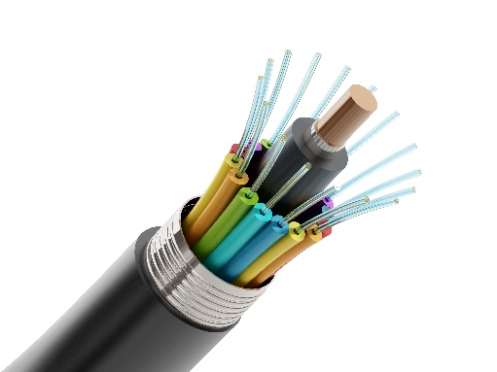
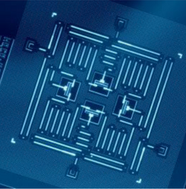
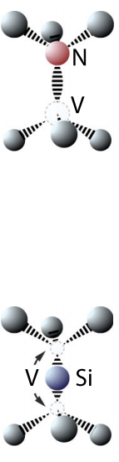
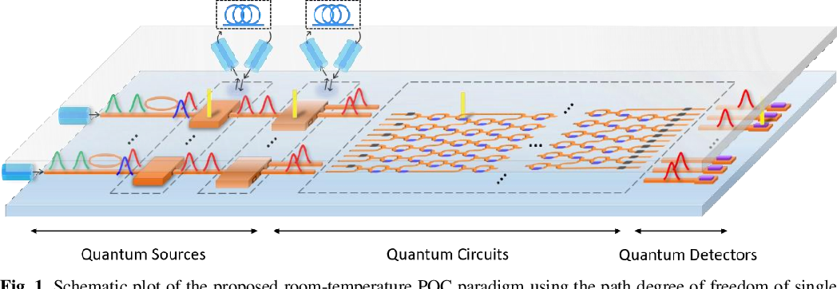
Hybrid Quantum Systems
Superconducting qubits:
Mature quantum computing platform
Highly scalable and reproducible
Fast gate operations
Requires millikelvin cooling
Limited coherence times
Defect center qubits:
Long coherence times
Optically addressable
Random nonuniform defect creation
Photonic qubits:
Ideal for long distance comm
Room temperature operation
Impossible to store
2-qubit operations difficult

Slide 3
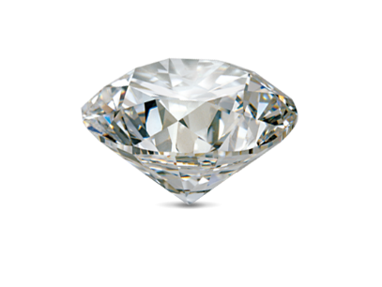
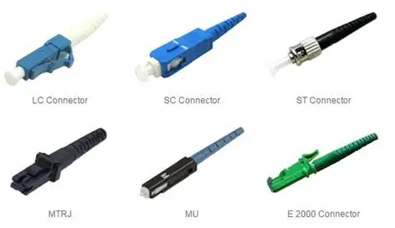
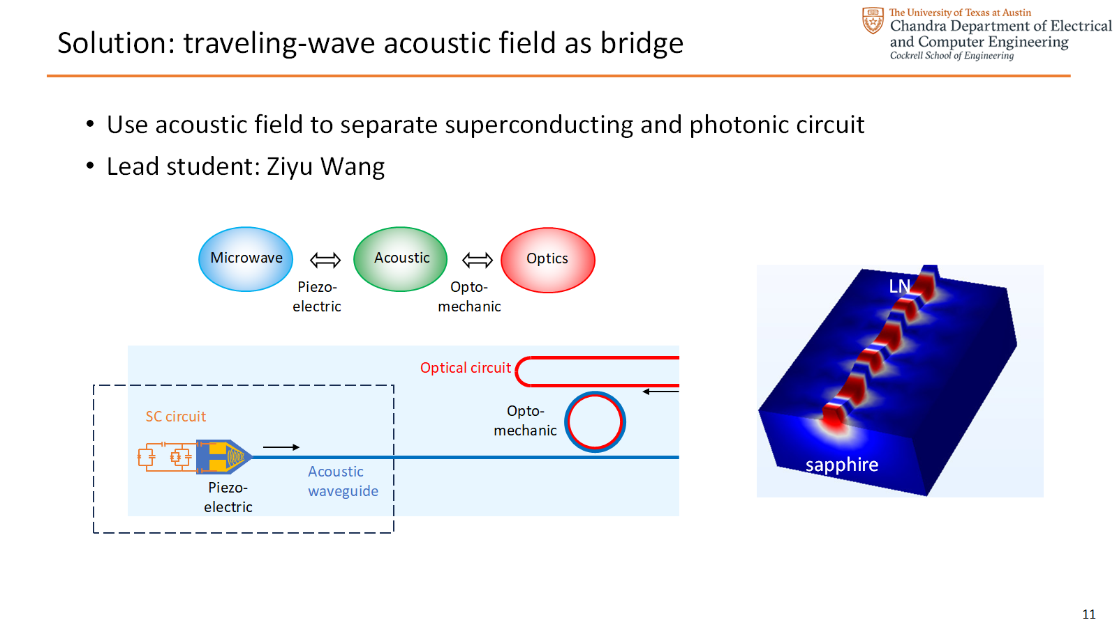
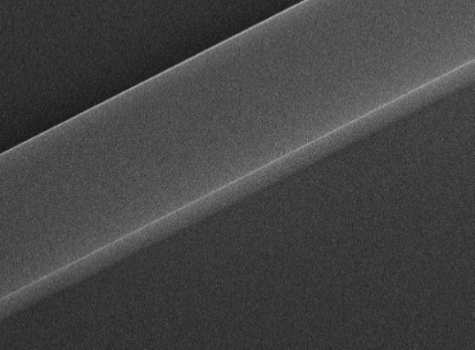
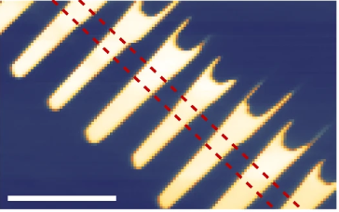

Optical Interconnects
Acousto-optic transducer:
2nd order optical nonlinearity:
Microwave
Acoustic
Telecom
Telecom
Visible
Piezo-
electric
Opto-
mechanic
$$χ^{(2)}$$
1 µm
20 µm

Slide 4
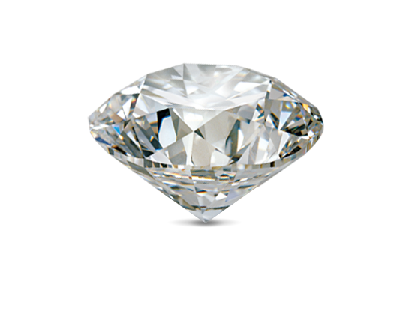
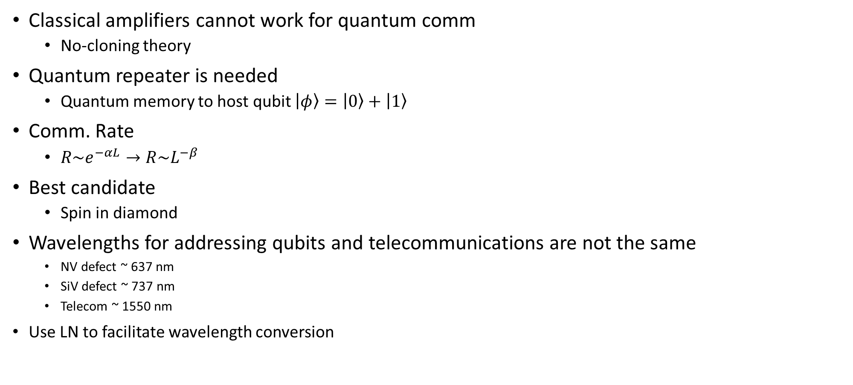
Quantum Optical Communications
Classical amplifiers cannot work for quantum comm
  No-cloning theory
Quantum repeater is needed
  Quantum memory to host qubit $\left.\left|φ\right.\right\rangle =\left.\left|0\right.\right\rangle +\left.\left|1\right.\right\rangle$
Comm. Rate
  $R\sim e^{−αL}→R\sim L^{−β}$
Best candidate
  Spin in diamond
Wavelengths for addressing qubits and telecommunications are not the same
  NV defect ~ 637 nm
  SiV defect ~ 737 nm
  Telecom ~ 1550 nm
Use LN to facilitate wavelength conversion

Slide 5
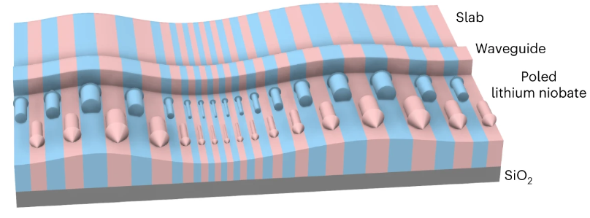
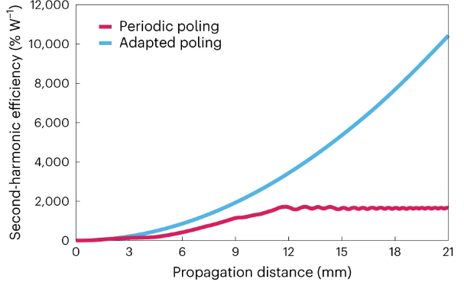
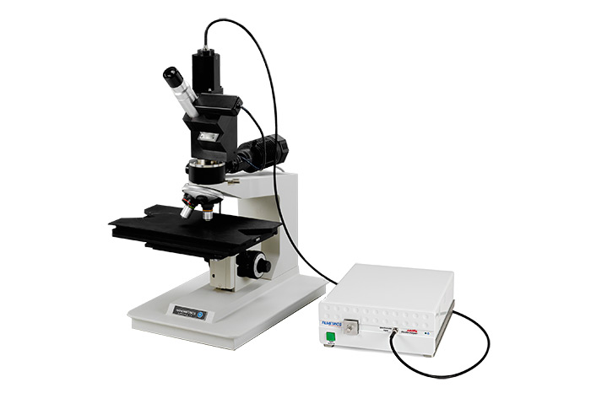
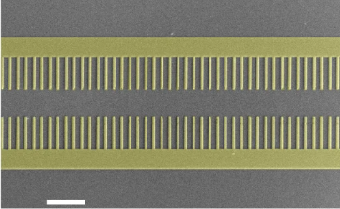
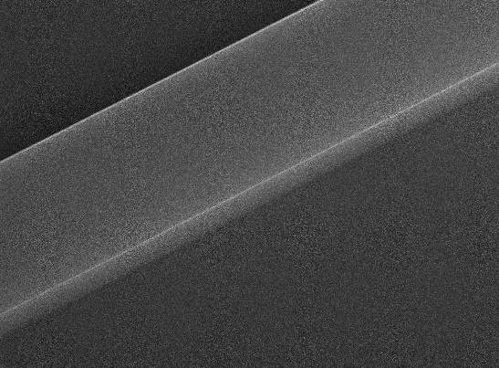
Adapted Poling for breaking nonlinear efficiency limit
Method: change poling period to compensate for thickness change
reflectometer
adapted poling
Etch waveguide
Chen, PK., Briggs, I., Cui, C. et al. Adapted poling to break the nonlinear efficiency limit in nanophotonic lithium niobate waveguides. Nat. Nanotechnol. 19, 44–50 (2024).

Slide 6
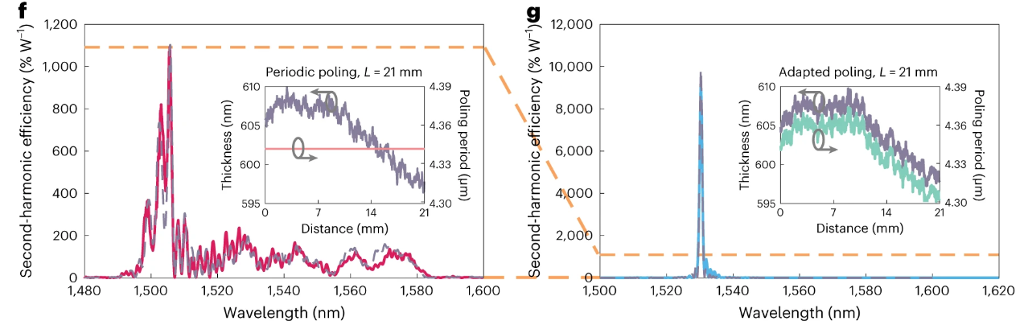
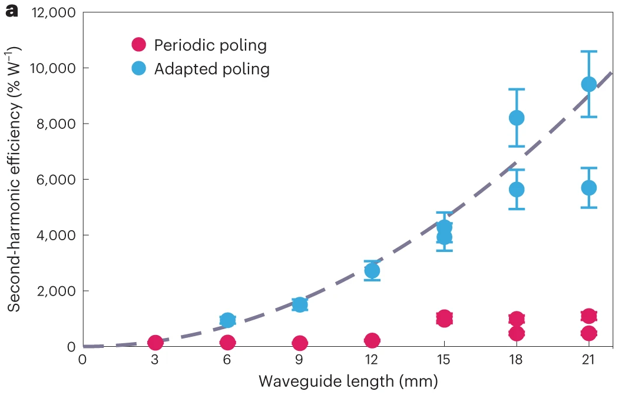
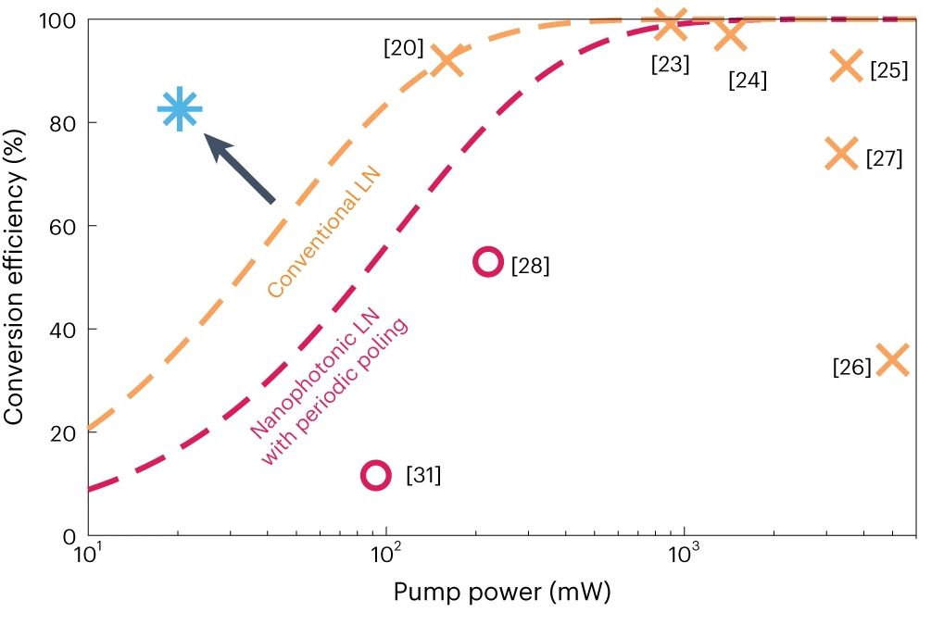
Adapted Poling for breaking nonlinear efficiency limit

Slide 7
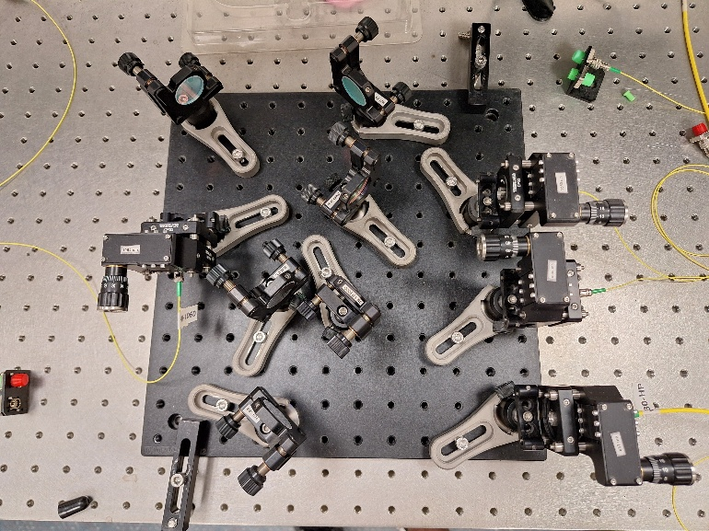
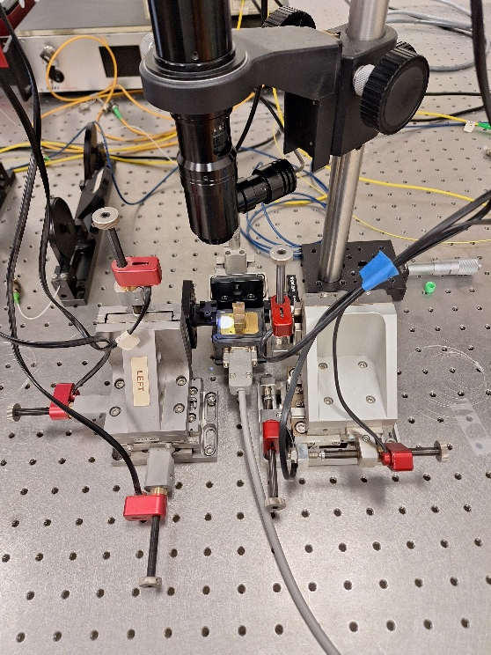
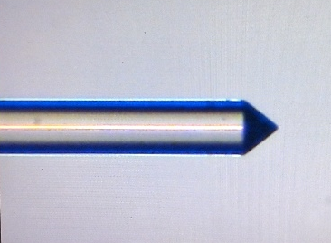

SFG experiment
1064 nm
637 nm
1587 nm pump
Lensed fiber used for waveguide coupling
Strong 1550 nm pump, fixed wavelength
1064 nm signal, wavelength swept
1550 nm
1064 nm
WDM
1064 nm
1550 nm
637 nm

Slide 8
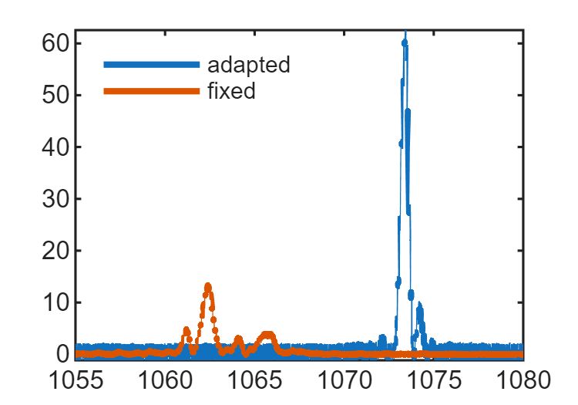


SFG experiment
Significant broadening seen for fixed poling period, sinc² peak recovered using adapted poling
375% higher efficiency for 20 mm device
$$\text{Output} \text{Power}\text{ (}\text{nW}\text{)}$$
$$\text{Wavelength}\text{ (}\text{nm}\text{)}$$

Slide 9
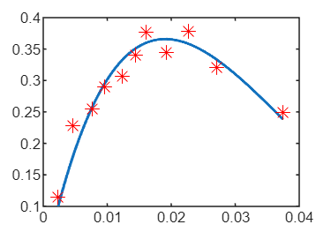



SFG experiment
$$η=η_{0}{\text{sin}}^{2}\left(\sqrt{η_{norm}P_{pump}}L\right)$$
SFG power dependence of 20 mm device measured using 1550 nm light as pump
$$\text{SFG} \text{Efficiency}$$
$$P_{max}≈18 \text{mW}$$
$$\text{On}\text{−}\text{chip} \text{Power}\text{ (}\text{W}\text{)}$$

Slide 10
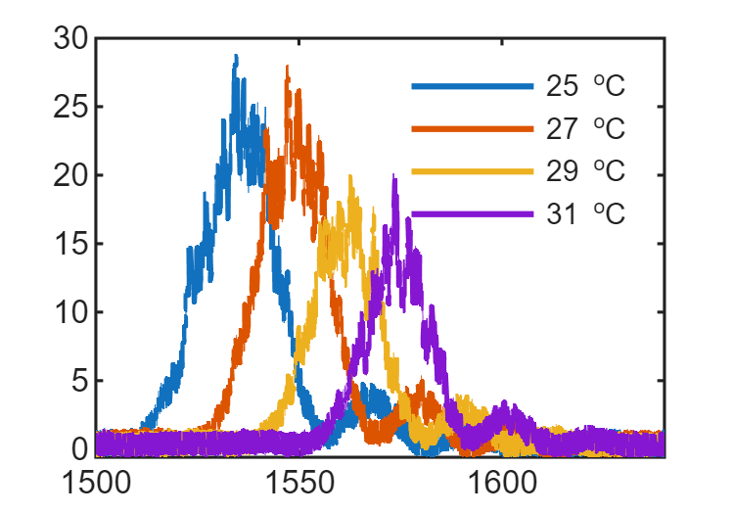
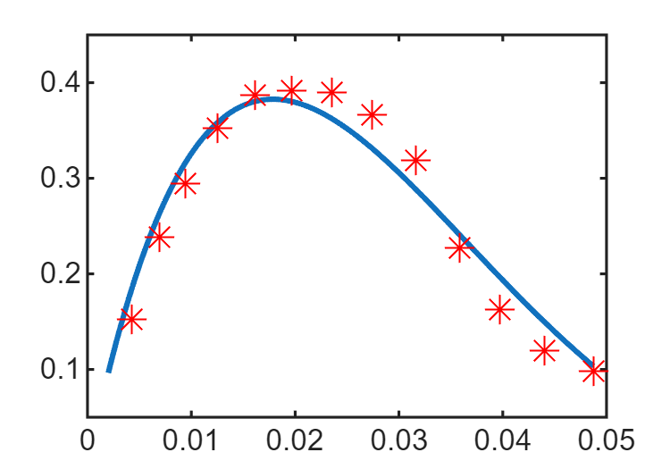




DFG experiments
637 nm
1064 nm
1587 nm pump
637 nm laser diode used as signal
Wavelength of 1550 nm pump swept to capture phase-matching curve
Measured efficiency in good agreement with SFG experiments
$$\text{Output} \text{Power}\text{ (}\text{nW}\text{)}$$
$$\text{D}\text{FG} \text{Efficiency}$$
$$P_{max}≈18 \text{mW}$$
$$\text{Wavelength}\text{ (}\text{nm}\text{)}$$
$$\text{On}\text{−}\text{chip} \text{Power}\text{ (}\text{W}\text{)}$$

Slide 11



Noise Overview
SHG
Raman
SHG-SPDC
$$λ_{p}=1550 \text{nm}$$
$$λ_{s}=1064 \text{nm}$$
$$λ_{nv}=637 \text{nm}$$
1st order noise processes:
S & AS Raman
SPDC
Cascaded noise processes:
SHG-SPDC
SHG-S & AS Raman
Efficient noise conversion

Slide 12
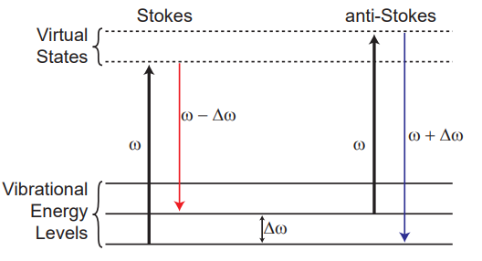






NV Center Quantum Frequency Conversion
NV Center ZPL 637 nm
1064 nm
1550 nm pump
$$η=η_{max}{\text{sin}}^{2}\left(\sqrt{η_{norm}P}L\right)$$
$$⟹$$
$$P_{max}=π^{2}/\left(4L^{2}η_{norm}\right)$$
Critical to QFC applications: sources of noise
Spontaneous Raman Scattering:
Spontaneous Parametric Down Conversion:
$$\text{NSD}∝PL \sim 1/L$$
$$\text{NSD}∝PL^{2}/N \sim 1/L$$
SHG - SPDC:
$$\text{NSD}∝P^{2}L^{4}/N^{2} \sim 1/L^{2}$$
SRS + NSPDC noise suppressed by length scaling

Slide 13
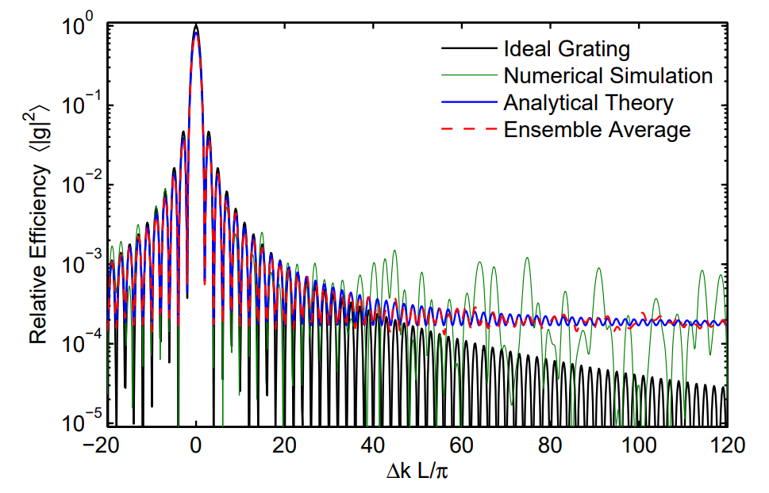

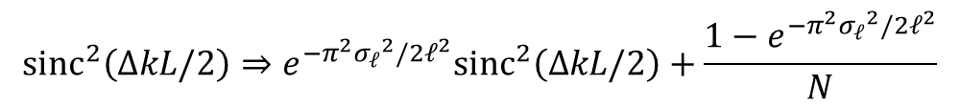







Spurious 2nd order nonlinear processes
For any 2nd order nonlinear process in an ideal grating, efficiency $η∝{\text{sinc}}^{2}\left(∆kL/2\right)$
Desired nonlinear process: $Δk=0$ , for all other processes: $ΔkL>100π$
$$ℓ$$
$$⋯$$
$$z_{1}$$
$$z_{2}$$
$$z_{3}$$
$$z_{4}$$
$$z_{k−1}$$
$$z_{k}$$
Duty Cycle (DC) error: $z_{k}\sim \text{Gauss}\left(\text{k}ℓ,{σ_{ℓ}}^{2}\right)$
Determined by quality of poling
$${\text{sinc}}^{2}\left(∆kL/2\right)⇒e^{−π^{2}{σ_{ℓ}}^{2}/2ℓ^{2}}{\text{sinc}}^{2}\left(∆kL/2\right)+\frac{1−e^{−π^{2}{σ_{ℓ}}^{2}/2ℓ^{2}}}{N}$$
spectral plateau term
Pelc, J.S. (2012). Frequency Conversion of Single Photons: Physics, Devices, and Applications [Doctoral Dissertation, Stanford University]

Slide 14
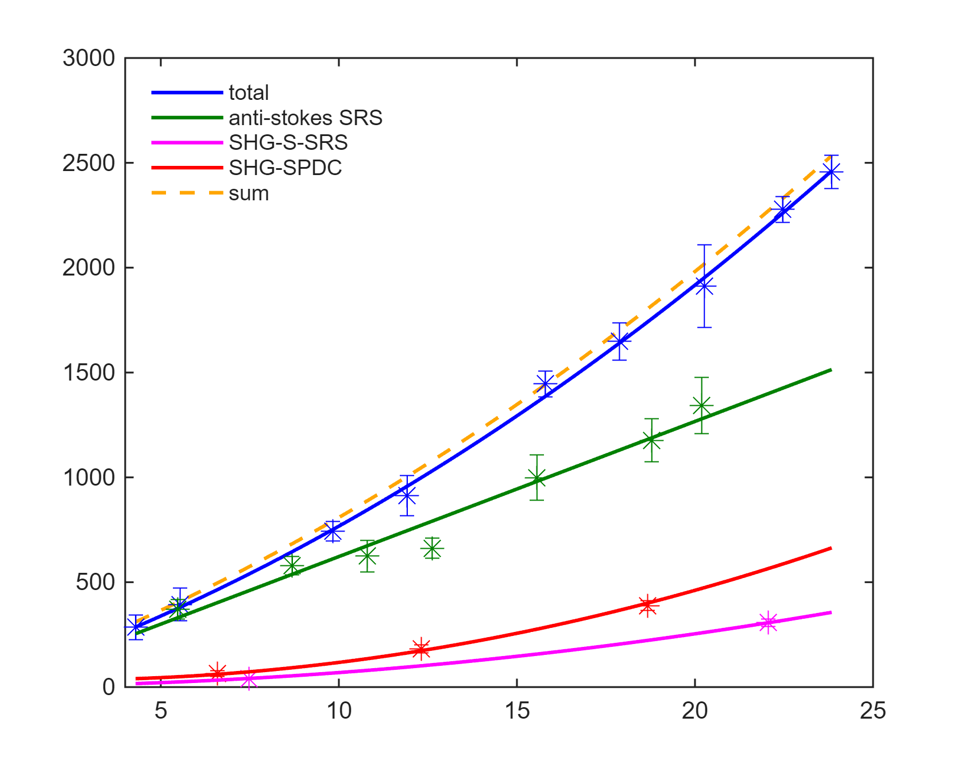
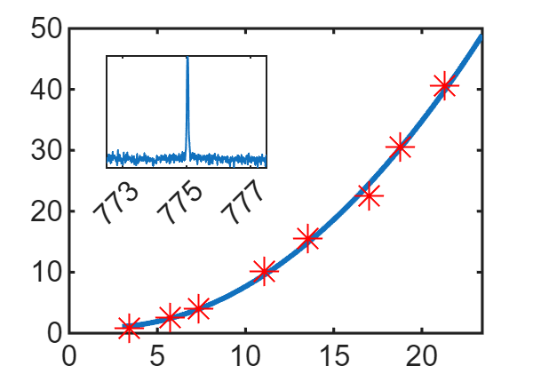







1064 nm noise measurement
1550 nm
1064 nm
WDM
1064 nm
1550 nm
637 nm
Same measurement setup, except 1064 nm is off, SNSPDs used at output, BPFs inserted for >100 dB isolation
anti-stokes SRS
$$1550 \text{nm}$$
SHG-S-SRS
$$\text{Noise} \text{Count} \text{Rate}\text{ (}\text{Hz}\text{)}$$
$$\text{SH} \text{Power}\text{ (}\text{nW}\text{)}$$
$$775 \text{nm}$$
SHG-SPDC
$$\text{On}\text{−}\text{chip} \text{Pump} \text{Power}\text{ (}\text{mW}\text{)}$$
$$775 \text{nm}$$
$$\text{On}\text{−}\text{chip} \text{Pump} \text{Power}\text{ (}\text{mW}\text{)}$$

Slide 15
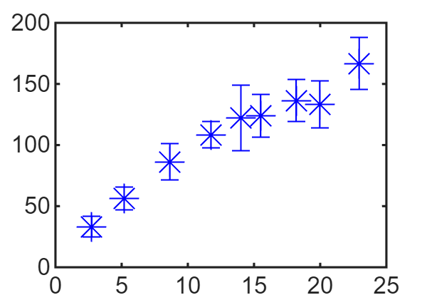
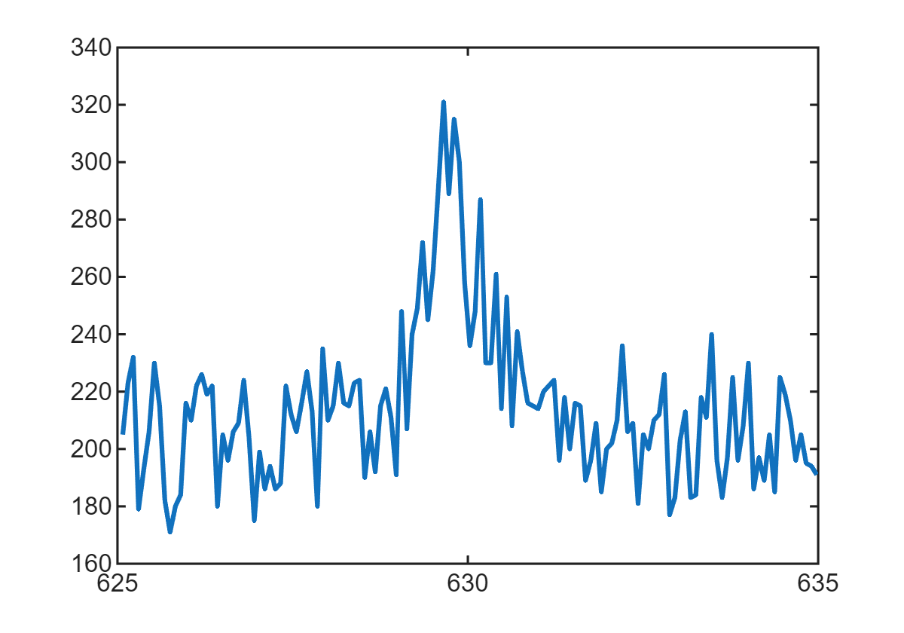





637 nm noise measurement
637 nm noise measured during all measurements
Significant 637 nm noise only measured during total noise measurement ⟶ 637 noise is upconverted from 1064 nm
Spectrometer used to measure noise spectrum: SFG spectrum reflected in noise spectrum
$$1550 \text{nm}$$
$$\text{Noise} \text{Count} \text{Rate}\text{ (}\text{Hz}\text{)}$$
$$Counts$$
$$\text{Wavelength}\text{ (}\text{nm}\text{)}$$
$$\text{On}\text{−}\text{chip} \text{Pump} \text{Power}\text{ (}\text{mW}\text{)}$$

Slide 16
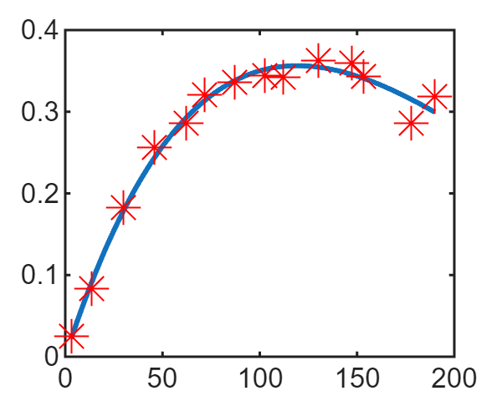
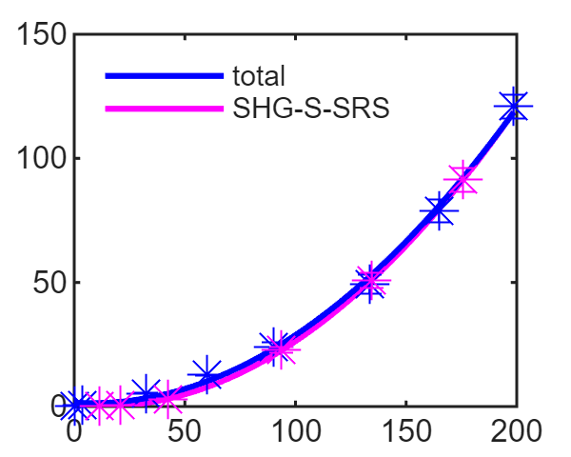
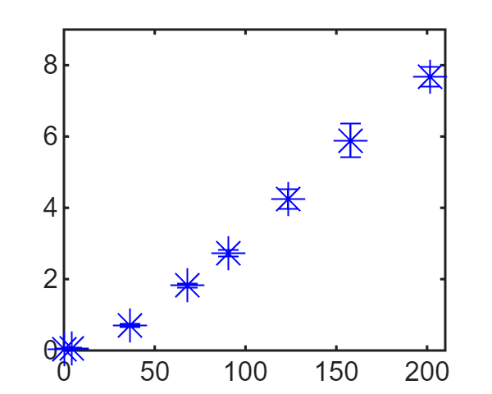








Device with fixed poling
For comparison, noise measurements are made with fixed poling device
Measured SFG efficiency of fixed poling device, maximum conversion at 120 mW
1064 nm noise entirely dominated by SHG-S-SRS noise
637 nm noise dominated by upconverted 1064 nm noise
$$1064 \text{nm}$$
$$637 \text{nm}$$
$$\text{SFG} \text{Efficiency}$$
$$\text{Noise} \text{Count} \text{Rate}\text{ (}\text{kHz}\text{)}$$
$$\text{Noise} \text{Count} \text{Rate}\text{ (}\text{kHz}\text{)}$$
$$\text{On}\text{−}\text{chip} \text{Pump} \text{Power}\text{ (}\text{mW}\text{)}$$
$$\text{On}\text{−}\text{chip} \text{Pump} \text{Power}\text{ (}\text{mW}\text{)}$$
$$\text{On}\text{−}\text{chip} \text{Pump} \text{Power}\text{ (}\text{mW}\text{)}$$

Slide 17
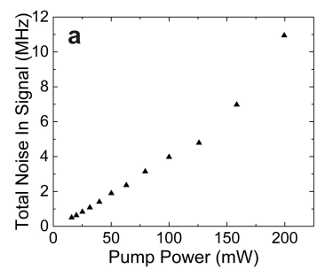
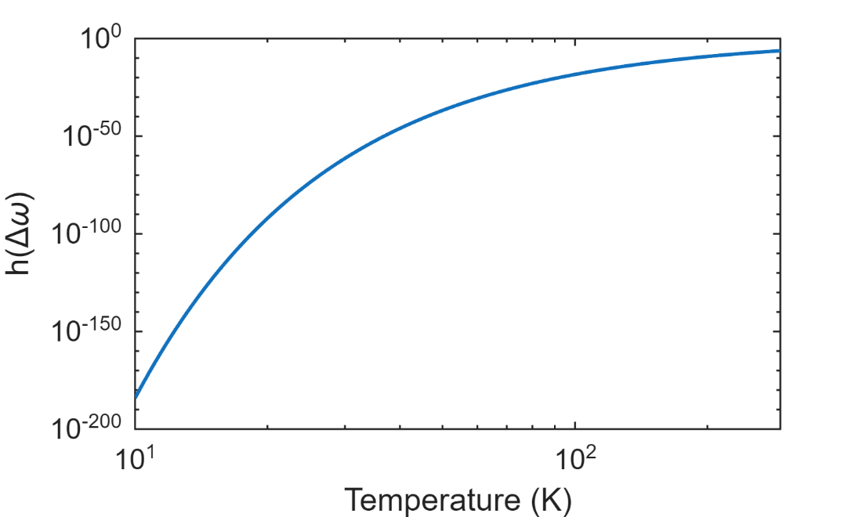

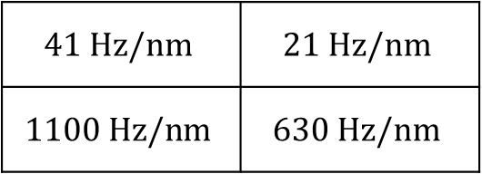


Noise comparison
1064 nm
637 nm
SHG-SPDC
adapted
$$41 Hz/nm$$ | $$21 Hz/nm$$
$$1100 Hz/nm$$ | $$630 Hz/nm$$
Raman
fixed
$$\left\langle n_{v}\left(Δω\right)\right\rangle$$
arXiv:2102.07044v1 [physics.optics] 14 Feb 2021
For anti-stokes SRS:
$$NSD∝\left\langle n_{v}\left(Δω\right)\right\rangle =\frac{1}{e^{ℏ\left|Δω\right|/k_{B}T}−1}$$
Using cooling, noise levels can be further reduced:
$$R_{1064}\sim 15 Hz/nm$$
$$R_{637}\sim 7.7 Hz/nm$$
$$\text{Temperature}\text{ (}\text{K}\text{)}$$

Slide 18
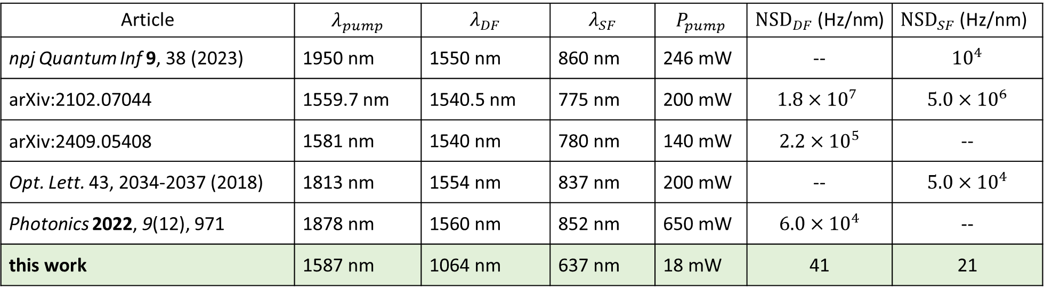
Noise comparison
Article | $$λ_{pump}$$ | $$λ_{DF}$$ | $$λ_{SF}$$ | $$P_{pump}$$ | ${\text{NSD}}_{DF}$ (Hz/nm) | ${\text{NSD}}_{SF}$ (Hz/nm)
npj Quantum Inf 9, 38 (2023) | 1950 nm | 1550 nm | 860 nm | 246 mW | -- | $${10}^{4}$$
arXiv:2102.07044 | 1559.7 nm | 1540.5 nm | 775 nm | 200 mW | $$1.8×{10}^{7}$$ | $$5.0×{10}^{6}$$
arXiv:2409.05408 | 1581 nm | 1540 nm | 780 nm | 140 mW | $$2.2×{10}^{5}$$ | --
Opt. Lett. 43, 2034-2037 (2018) | 1813 nm | 1554 nm | 837 nm | 200 mW | -- | $$5.0×{10}^{4}$$
Photonics 2022, 9(12), 971 | 1878 nm | 1560 nm | 852 nm | 650 mW | $$6.0×{10}^{4}$$ | --
this work | 1587 nm | 1064 nm | 637 nm | 18 mW | 41 | 21

Slide 19
Surface Acoustic Wave devices for Superconducting Qubit Control
Traveling-wave acoustic field as bridge
Use acoustic field to separate superconducting and photonic circuit

Slide 20
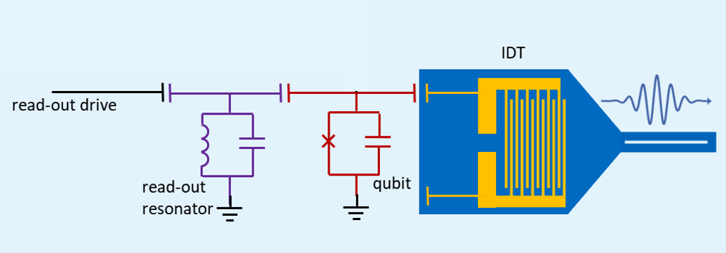
Superconducting components
  Transmon qubit (red)
  Qubit drive and read-out (purple)

Slide 21
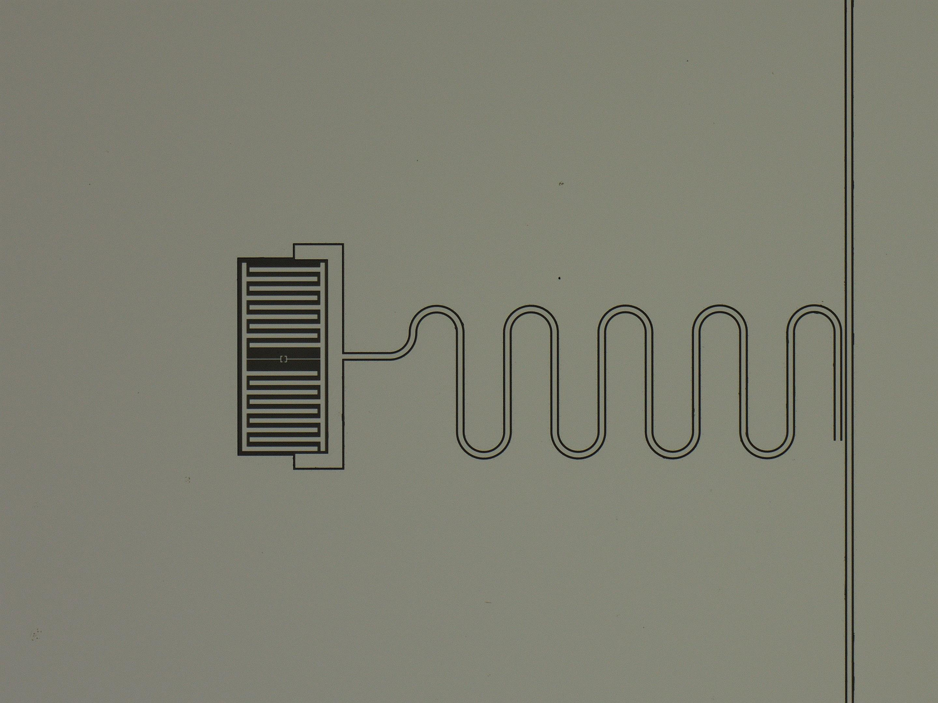
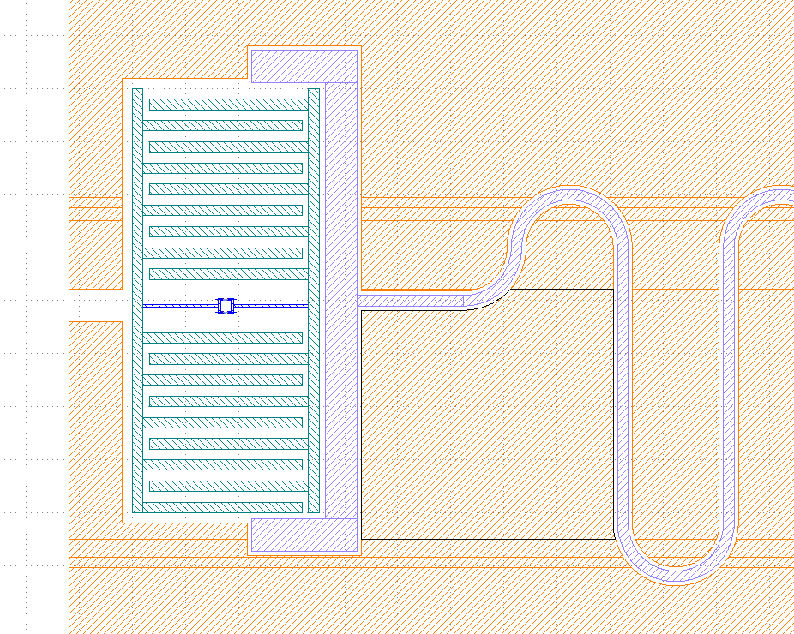
Superconducting components
transmon and read out resonator
Josephson Junction

Slide 22
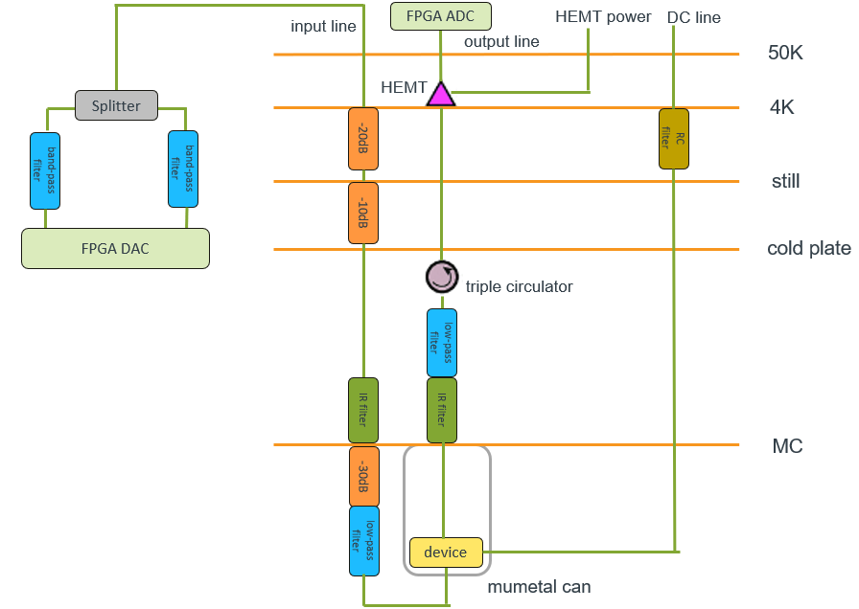
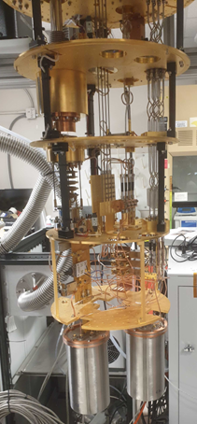
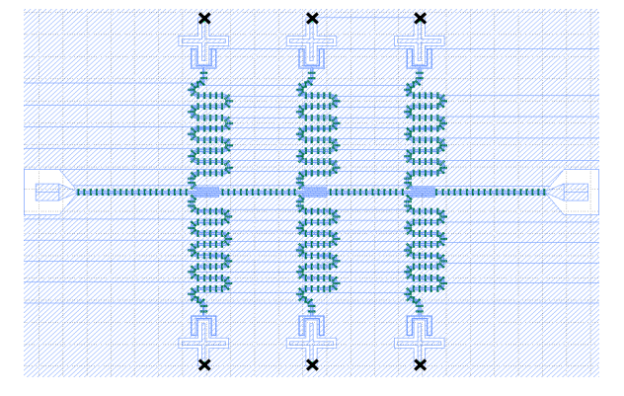
Measurement

Slide 23
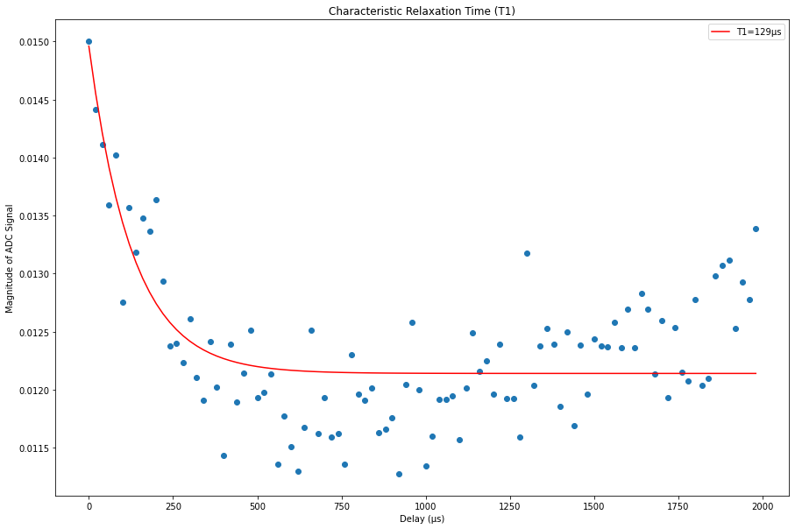
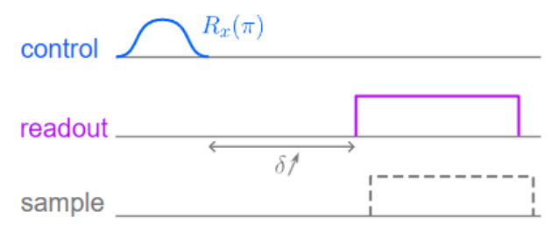
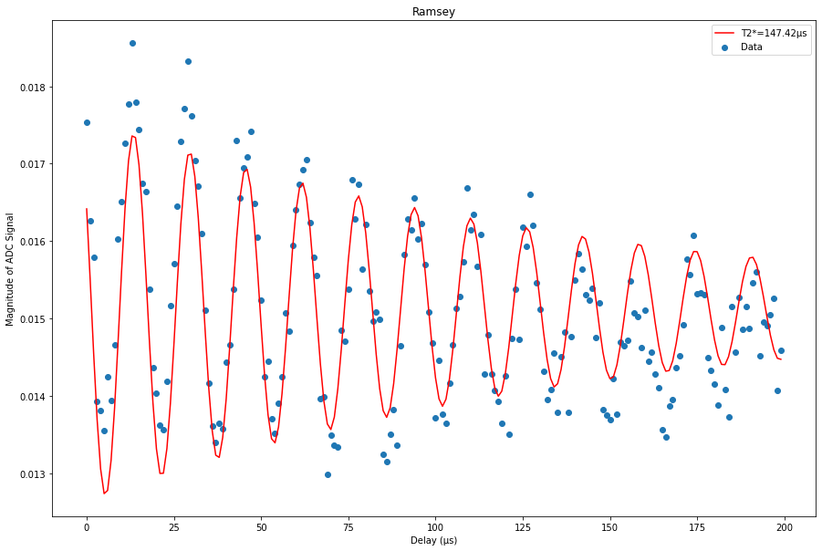
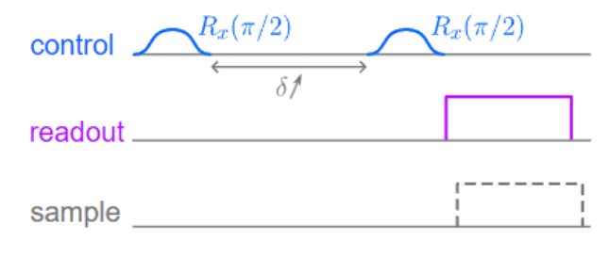
FPGA Measurement
T1 experiment
the relaxation time of qubit: 129us
T2 Ramsey experiment
the dephasing time of qubit: 147.72us

Slide 24

Material selection for integrated acoustics
To form an acoustic wave, the candidates are:
Substrate: Sapphire
Waveguide: GaN/LiNbO3

Slide 25




IDT Measurement
Max S12 = -22.85dB

Slide 26


IDT Cryo Measurement
Power: -20 dBm
Max S12: -66.3 dB
Deducting all the cables inside and outside the fridge: 13.3 dB

Slide 27

Summary
Demonstrated low power maximum wavelength conversion for NV centers, $P_{max}=18 \text{mW}$
Measured record-low on-chip noise generation for NV center wavelength conversion
Calibrate qubit measurement line in dilution fridge
Measured acoustic wave insertion loss around 13dB at cryogenic condition

Slide 28






Acknowledgements

